Slide 1
Principles of design & ergonomics

Slide 2
What’s on the menu?
The principles of design and the principles of ergonomics are closely related.
We'll start with a few design principles, then move on to ergonomics.
Notes:
Slide Purpose Introduce the overall theme: the core principles of usability (sometimes called ergonomics) in digital product design.
Good usability significantly impacts project success and user satisfaction.
Well-designed products can reduce frustration, improve adoption, and enhance brand reputation.

Slide 3
Summary
Throughout this course, you will explore the essential principles that drive intuitive and effective user experiences. You will learn how design decisions impact usability, and how visual structure, consistency, and user feedback will shape the way people interact with digital products.
You will understand how to:
Apply core design principles (alignment, hierarchy, contrast, proximity)
Evaluate interfaces using usability heuristics
Reduce cognitive load and improve navigation flow
Design with accessibility and inclusivity in mind
Create user-friendly, responsive layouts that enhance the user journey
These principles will be at the heart of successful UX design. As you progress, you will apply a user-centered mindset, test your ideas, and iterate based on feedback.

Slide 4
Principles of Design
Let’s start with… typography and color
Then, we will explore a lot of Core Design Principles
And… we will have a look at UX/UI Laws & Best Practices
« Simplicity, carried to the extreme, becomes elegance »
Jon Franklin

Slide 5
But first…
Let’s test your attention to details!
→ https://cantunsee.space/

Slide 6
Typography
Typography is a core component of user interface (UI) design. It’s the art and technique of arranging text to be both visually appealing and easy to read.
Good typography isn’t just about choosing a fancy font — it’s about creating a visual hierarchy, ensuring readability, and setting the tone for your brand.
When done right, typography can enhance user experience and make your design stand out.

Slide 7
Typography helps to
Attract users with typefaces and typographic elements that grab their attention even before they start reading.
Set visual hierarchy with consistent type sizes, weights, serif and/or sans-serif fonts, font pairings, and typeface combinations to guide users and improve readability.
Build brand recognition. When used consistently, good typography helps users identify your brand through the typeface and font styles used for your branded content.
Supports content goals. Consistent letter spacing, line lengths, upper and lowercase letters, and other typographic elements boost legibility, while fonts used as graphic design elements amplify tone and meaning.

Slide 8
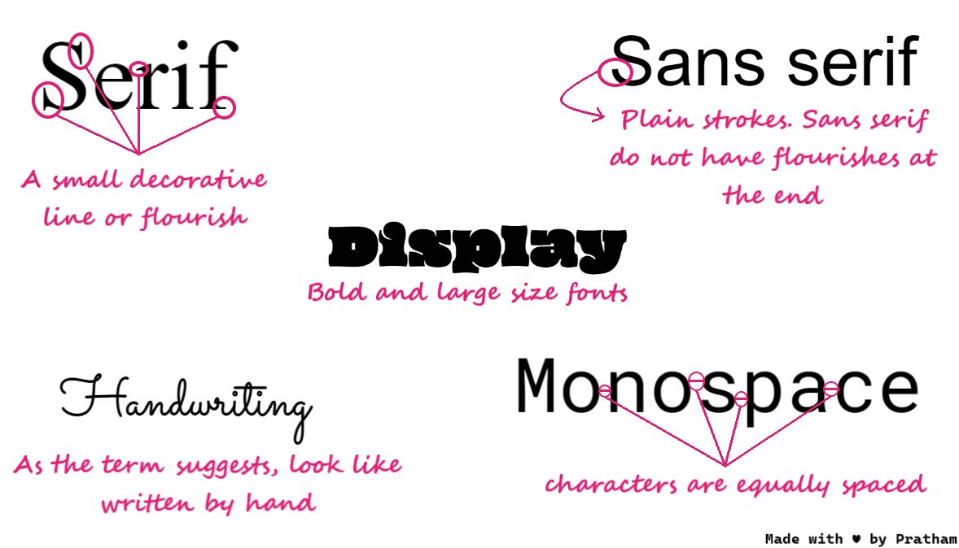
Font types - Typography
Serif: Traditional and formal, with small strokes on letters. Used by brands like The New York Times and J.P. Morgan. Examples: Times New Roman, Garamond.
Sans-serif: Modern and clean, often used by tech brands (Airbnb, Target). Examples: Helvetica, Arial, Calibri.
Script: Flowing, cursive style for decorative use. Examples: Snell Roundhand, Pacifico, Scriptina.
Monospace: Fixed-width letters, often used in coding. Examples: Courier, Source Code Pro.
Display: Also known as decorative, great for logos and banners. Examples: Clearview, Johnston, Skywalker.
Source: https://discuss.boardinfinity.com/t/getting-good-with-css-part-2/4741

Slide 9
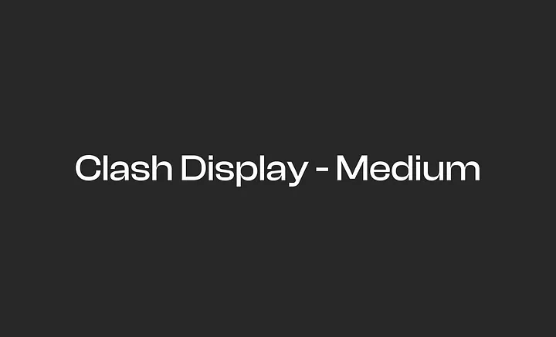
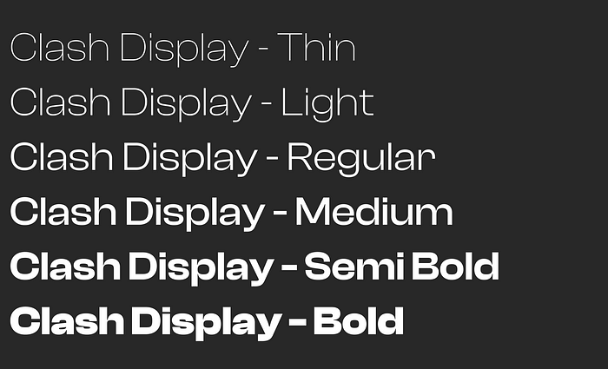
Font types - Typography
Font family
A font family is a group of related fonts.
Clash Display Thin, Clash Display Light, Clash Display Regular, Clash Display Medium, Clash Display Semi-Bold, Clash Display Bold.
All of these are a collection. All this into one is a font family.
Font
A font is a specific style within a typeface which varies in weight and size.
For example, Clash Display is a typeface and Clash Display Medium is a font.
Source: https://uxplanet.org/principles-of-typography-in-ui-design-bc28f1f9666d

Slide 10
Text Aligned - Typography
To achieve balance and help users easily move down a page, align design elements, such as your logo, an image, header, and body text. Equally space each design quote but employ margins and padding consistently. Left-, right-, full- or center-justify your text based on your project needs. For example, designers may center-justify a heading or short quote but left-justify long-form copy.
Left-aligned text is the most common setting for left- to-right languages such as English.
Centered text is best used to distinguishing short typographic elements within a layout (such as pull quotes), and is not recommended for long copy.
Right-aligned text is the most common setting for right-to-left languages, such as Arabic and Hebrew.
‘’
‘’

Slide 11
Line & Letter Spacing and Kerning - Typography
Line Spacing
Also known as Leading, it is adjusting the space between all characters in a line, Vertically.
Aim for about 140%-180% for optimal readability and accessibility.
Limit line length to 70–80 characters.
Font size should be minimum 16pt. The bigger the screen the bigger the text.
Small fonts need more spacing.

Slide 12
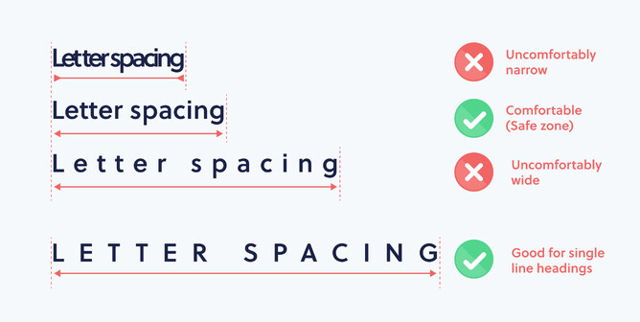
Line & Letter Spacing and Kerning - Typography
Letter Spacing
Also known as Tracking, it is adjusting the space between lines of text
Larger type sizes, such as headlines, use tighter letter-spacing to improve readability and reduce space between letters.
Kerning
Kerning is adjusting the spacing between individual characters in a piece of text.
Unlike letter-spacing (tracking), which affects the spacing across an entire block of text, kerning is applied to individual character pairs to correct visual inconsistencies.
Source: https://www.rocketspark.com

Slide 13
EXERCISE
Do you want to try ?

Slide 14
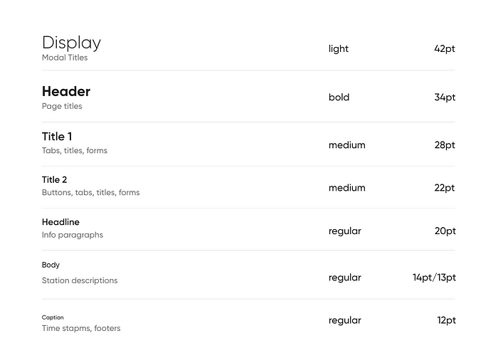
Hierarchy - Typography
Hierarchy is arranging text based on the importance of information.
This can be achieved through font size, weight, and style. Here’s a simple definition:
Headings: Typically the largest and boldest text, used for titles and key sections.
Subheadings: Smaller than headings but larger than body text, used to separate content.
Body Text: The standard size for regular content.
Captions/Labels: Smaller than body text, used for annotations or additional information.
Also, use various title sizes (H1 to H6) to show their importance.
Source: https://medium.com/

Slide 15
Pairing Fonts - Typography
Contrast but Complement – Pair fonts with distinct styles (e.g., serif + sans-serif) while ensuring they harmonize.
Limit to Two or Three Fonts – Too many fonts create clutter; stick to a primary, secondary, and optional accent font.
Use Hierarchy – Assign different fonts for headings, subheadings, and body text to create visual structure.
Match Mood & Purpose – Choose fonts that align with your brand or message (e.g., modern for tech, elegant for luxury).
Check Readability – Ensure legibility across different screen sizes and formats.
Pair Fonts from the Same Family – Using font variations (bold, italic, light) creates consistency without clashing.
Test Before Finalizing – Experiment with font combinations to see how they interact in real-world applications.

Slide 16
Tools - Typography
Free Web licensed Fonts
Font Inspector (find out the fonts used in a webpage)
Pairing tools:
https://www.monotype.com/font-pairing
https://www.fontshare.com/

Slide 17

Colors
“Color is a power which directly influences the soul.” Wassily Kandinsky
Colours Attract Emotion
Source: https://blog.kleinpixelagency.com/design-guide-4ad204de2e8a
Yes it matters! Funny charts

Slide 18
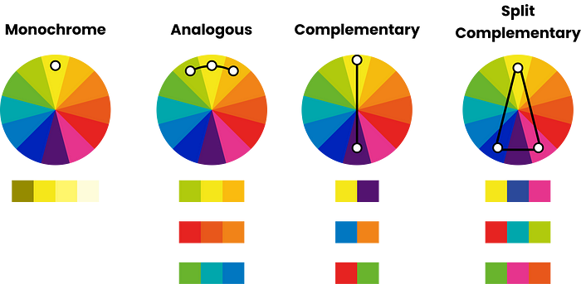
Colour Pairing
There are several ways to pick a colour palette. Here you will find the most commonly used techniques:
Monochrome pairing uses the different values of the same colour. Monochrome is used mostly with black and white designs, but that is not the only way to use it.
Analogous pairing uses 3 adjacent colours on the colour wheel.
Complementary pairing uses 2 colours on opposite sides of the colour wheel.
Split complementary pairing uses one colour and opposite colour’s two adjacents.
Source: https://blog.kleinpixelagency.com/design-guide-4ad204de2e8a

Slide 19

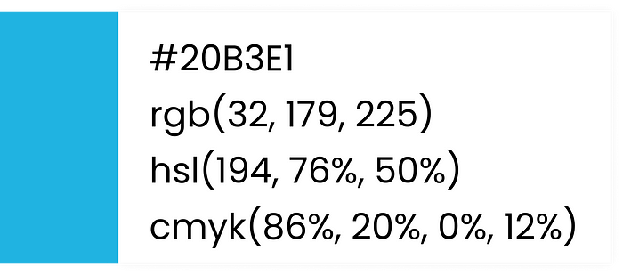
Colour Formats
HEX: Short for hexadecimal, HEX colors use numbers (0-9) and letters (A-F). In #20B3E1, "20" is red, "B3" is green, and "E1" is blue.
RGB: A widely used format with values from 0 to 255 for Red, Green, and Blue. Adding "A" (RGBA) adjusts opacity. Example: rgb(32,179,225), rgba(32,179,225,0.3).
HSL: Stands for Hue (0-360°), Saturation (0-100%), and Lightness (0-100%). HSLA includes an alpha channel for opacity.
CMYK: Used in printing, representing Cyan, Magenta, Yellow, and Black (Key) with values from 0% to 100%.

Slide 20
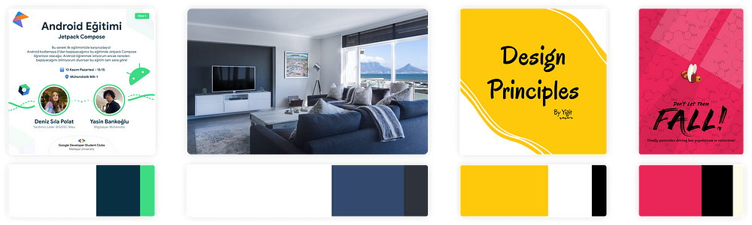
60/30/10 Rule
60 / 30 / 10 rule is one of the most helpful guidelines in design. It is used in UI design, branding, graphic design, photography and even in interior design.
60% is typically a neutral color that forms the base of your design. It’s often used for the background. Keep in mind high saturated colours can be hard to look at for long periods.
30% is the secondary color. It adds visual interest. It can be used for text, borders, or other elements that support the design.
10% is the accent colour. It’s used mostly for highlights or elements that require the viewers attention, such as call-to-action buttons.
Source: https://blog.kleinpixelagency.com/design-guide-4ad204de2e8a

Slide 21
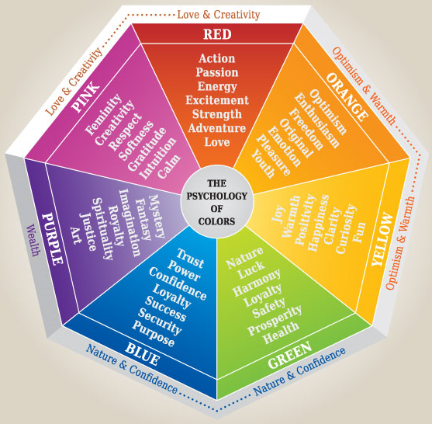
The Psychology of Colors
A brilliant infographic
And… many tools:
https://coolors.co/
https://flatuicolors.com/
https://colorhunt.co/
https://color.adobe.com/
https://www.figma.com/color-palette-generator/
And from an image:
https://coolors.co/image-picker
https://palettegenerator.com/
Source: https://predictiveux.com/insights/color-theory-what-colors-mean
Notes:
Understanding the psychology of color can better help you design for your goals:
Red is a strong color and can elicit reactions from people. It can represent passion or danger, but lightened to pink it can instead represent romanticism and femininity, and darkening it to maroon can impart a more traditional feel. Red can be a good color for call-to-actions
Orange is an energetic color that can call back to adventure, youth, and creativity. It’s also tied to the 1970s and can be used to create a retro feel!
Yellow is considered to be happy, cheerful, and optimistic. Pastel hues of yellow can be used for soft backgrounds, whereas brighter yellows can be callout colors or to express creativity. Darker yellows can come across as gold, which suggests wealth or success—but be careful when darkening not to muddy the yellow!
Green is pretty universally connected to nature, and thus can represent renewal, growth, and sustainability. Dark green can represent money, prosperity, and stability. Like red, green can be a good color for call-to-actions, but it can also serve as a good main color for your site too.
Blue is a calm color that can be relaxing and can signal intelligence. Lighter blues tend to be viewed as more peaceful while darker blues are seen as more powerful. Blue is a common brand color for websites and companies, such as Facebook, LinkedIn, IBM, and Paypal.
Purple has historically been linked to royalty, wealth, and luxury as well as mysticism and spirituality. It can also evoke creativity. Like green, purple can act as a good callout or background color, depending on the shade you choose.
Black is another color that is associated with power and elegance. It can also be used to create a mysterious or cool look. Black can make things look more sleek and can impart both modernity and timelessness. It’s also a neutral color that works well with other colors, in typography, and as a grounding element in design.
White can be seen as minimalist or innocent. As another neutral color, there’s a lot you can do with white in your design, and pairing it with other colors can compound their effects to create the exact look you want.
Gray can have many different meanings, ranging from serious to sophisticated to conventional. For some, it represents formality and dependability. Like with the other neutral colors, it can provide a centering element in your design.
Brown is another color associated with nature. It can be seen as warm, friendly, and outdoorsy. You can use brown to play up the idea of warmth or wholesomeness, pair it with green for an ecofriendly feel, or use it to create a sense of heritage and tradition.

Slide 22
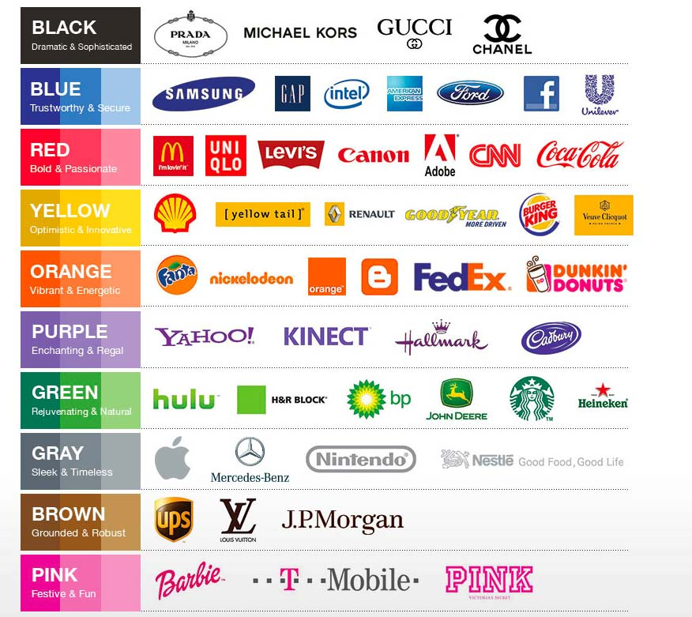
The Psychology of Colors
Examples
Source: https://www.alexarzuman.com/2013/05/couleur-design-graphique-signification/

Slide 23
Don’t forget accessibility!
While checking contrast between two colours, we should keep in mind that, everyone is different and might have different visual limitations. Some people don’t see well, some have colour blindnesses, and some have technological limitations. Just because you see everything clearly on your screen doesn’t mean everyone have the same standarts.
https://webaim.org/resources/contrastchecker/
But you'll have a whole course on the subject

Slide 24
Intuitive design Definition
The term “intuitive design” refers to designing digital experiences that your target users find easy to use — be it a website, a product, or an app.
This includes visual designs like iconography or functional designs like buttons. The measure of success for an intuitively designed website, for example, is if a user is able to approach the site and understand how to use it with little effort.

Slide 25
Intuitive design Basic principles
Attributes of intuitive design for user interfaces?
Discoverability: The user should be able to find information as they need it. The starting point and next steps should be clear and the layout should be straightforward.
Affordance: The user should get hints as to what elements will take them to a subsequent step. Examples of this are buttons and consistent clickable elements from page to page.
Comprehensibility: The user should be able to understand the textual and visual information at a glance. This means simple language should be used, avoiding jargon.
Responsive feedback: The user should be able to tell immediately the success or failure of their actions. The results should be visible.
Predictability: The user should be able to reliably predict what results will follow an action. The results should meet expectations and not cause confusion.
Efficiency: The user should be able to complete an action with one try, without repetition or unnecessary steps.
Forgiveness: The user should be prevented from making mistakes, but if they make one, it should be easy to recover.
Explorability: The user should feel confident exploring a site. They should never feel lost or afraid of making a mistake.

Slide 26
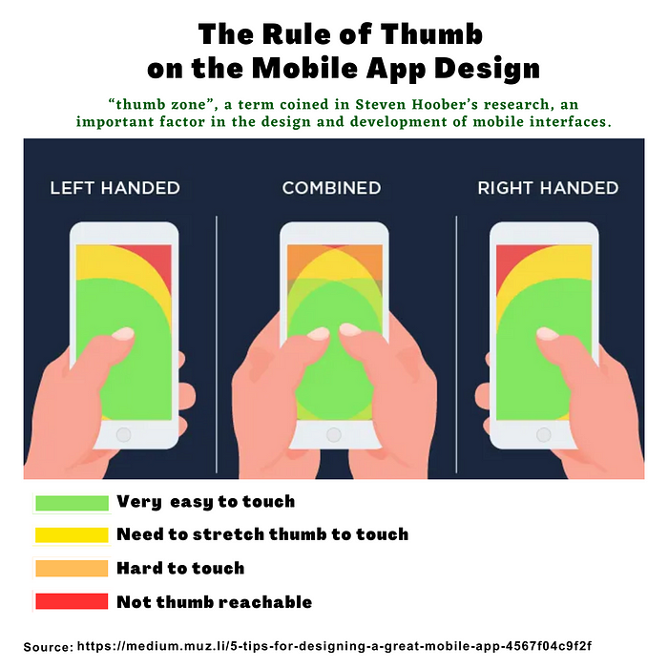
Intuitive design Basic principles
Rules of thumb to keep in mind
Keep your logo in the upper left corner clickable on all pages of your site to allow user to return to homepage
Maintain a way to navigate to “contact” your company on every page
Consistent headers & footers on every page, in location on-page and options
Accessibility must be a consideration to cater to all users and abilities
Plain language trumps overly clever or branded language every time
Consider experiences from device to device (depending on your own users’ behaviors, of course)

Slide 27
Intuitive design Basic principles
What is affordance in UX design?
Affordance refers to the way that the design of a product or interface communicates to the user the actions that are possible or appropriate to take. This can include both physical and perceptual affordances.
For example, in a digital interface, buttons and links often have a specific visual appearance that indicates to the user that they can be clicked or tapped. This is a perceptual affordance, as it relies on the user's interpretation of the visual cues to understand the potential for interaction.
Designers can use affordances to make products and interfaces more intuitive and easy to use by ensuring that the design communicates the potential for interaction clearly and consistently. This can help to reduce frustration and improve the overall user experience.

Slide 28

Benefits of applying Ul design principles
Enhances usability
Increases efficiency
Improves decision-making
Decreases cognitive load
Source: https://www.freepik.com/

Slide 29
1.Enhances usability
A usable interface: Usability is a measure of how well a specific user in a specific context can use a product/design to achieve a defined goal effectively, efficiently and satisfactorily.
We will come back to usability further and… deeper!
Enjoyable
Usable
Reliable
Functional
Do this
Much like Maslow's hierarchy, Aarron Walter's hierarchy of user needs defines basic user needs that interfaces must fulfill before more advanced needs can be addressed.
Notes:
Enhances usability. “Think of a user as someone asking you directions. If you just showed them a map and expected them to memorize it, they'll probably get lost,” Tom says. “But if you point them to a sign that says their destination is this way, they can follow the signs from there … That's a much better experience. UI design principles help you set up signs users can follow towards their goals—one click, scroll, or interaction at a time.”

Slide 30

2.Increases efficiency
By streamlining processes and reducing unnecessary steps, design principles help users complete tasks faster. A clear hierarchy, minimal distractions, and smart automation contribute to smooth workflows.
Source: https://www.revechat.com/blog/5-ways-increase-efficiency-support-team/
Notes:
Increases efficiency. Aligning UI design principles at the start of projects lifts the cognitive load for designers, streamlining workflows and making product teams more efficient. Figma data analysts found that participants with access to a design system completed their design objective 34% faster than those without one.

Slide 31
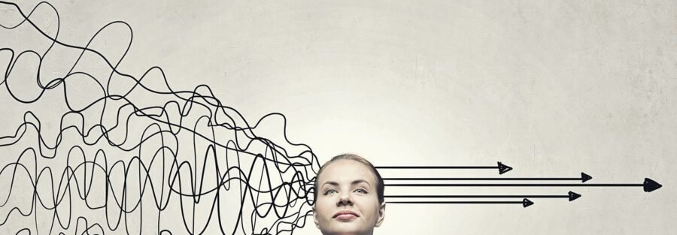
3.Improves decision-making
Good design reduces decision fatigue by organizing information logically, minimizing choices, and emphasizing key actions. This allows users to make quicker and more confident decisions.
Source: https://www.cxtoday.com/contact-center/real-time-decision-making-empowering-your-team-for-immediate-customer-solutions/
Notes:
Improves decision-making. Clear and consistent UI design principles give a structured framework for predicting user needs and making informed design choices.

Slide 32

4. Decreases cognitive load
Definition: The amount of mental resources needed to understand and interact with an interface.
Causes
Too many choices
Too much thought required
Lack of clarity
Each of these factors will require processing and takes up mental resources that doesn’t actually help users understand the content.
Source: https://www.healthysimulation.com/hearing-voices-psychiatry-simulation/
Notes:
Reduces cognitive load. A well-designed interface can simplify tasks, reducing the mental effort required to complete user actions. Less cognitive load can help create a more intuitive and enjoyable experience.

Slide 33
4. Decreases cognitive load
Methods for Reducing Cognitive Load
Remove Unnecessary Elements: Keep designs simple and avoid clutter that distracts users.
Use Familiar Design Patterns: Leverage common UI patterns to reduce learning effort.
Eliminate Extra Tasks: Reduce reading, memory load, and decision-making for users.
Minimize Choices: Limit options to prevent decision paralysis.
Group Related Options: Display choices together to ensure users see all available options.
Ensure Readability: Use clear typography and an intuitive layout for better comprehension.
Use Icons Carefully: Accompany icons with text to avoid confusion and reduce mental effort.

Slide 34
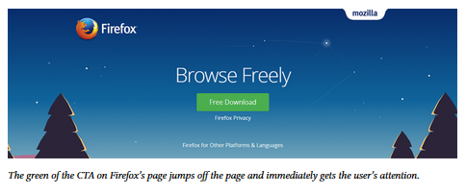
Before going on…
Calls to action (CTA) are buttons that guide users towards a specific goal.
Visual prominence. The colors.
Negative spacing: pay attention to the space around buttons.
Action-oriented text: write text for the button that will lead visitors to take an action. Ex: “Start”, “Get” or “Join ".
Color as visual prominence
Source: https://www.mozilla.org/fr/

Slide 35
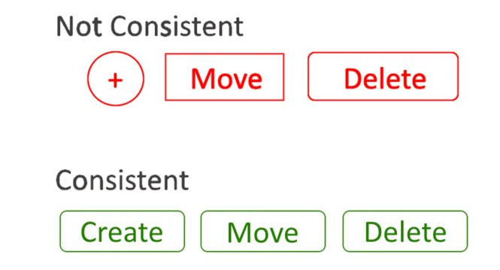
CTA
Make sure clickable elements look just like them.
Label buttons according to what they do.
Design buttons consistently
Size: 5-second test (https://data36.com/five-second-testing/)
Material Design: great button examples https://material.io/design/components/buttons.html
Source: https://www.intlum.com/blog/web-design-guide/

Slide 36
A lot of principles (but not all)

Slide 37
Design principles
Design principles serve as guidelines to help designers create visually appealing and functional designs. Rather than being formally documented, these principles are often learned through observation and practice, as no single set of rules applies universally to all designs.
Every design problem needs its own solution.
By applying these principles, designers can enhance both aesthetics and usability, making their work more engaging and user-friendly. Ultimately, this leads to a better user experience and greater satisfaction with the product or service.

Slide 38
Alignment
Alignment is one of the most important factors in creating a good design.
When content is aligned, it creates a sense of unity and order, which makes it easier for people to scan through your designs and understand what they’re looking at.

Slide 39
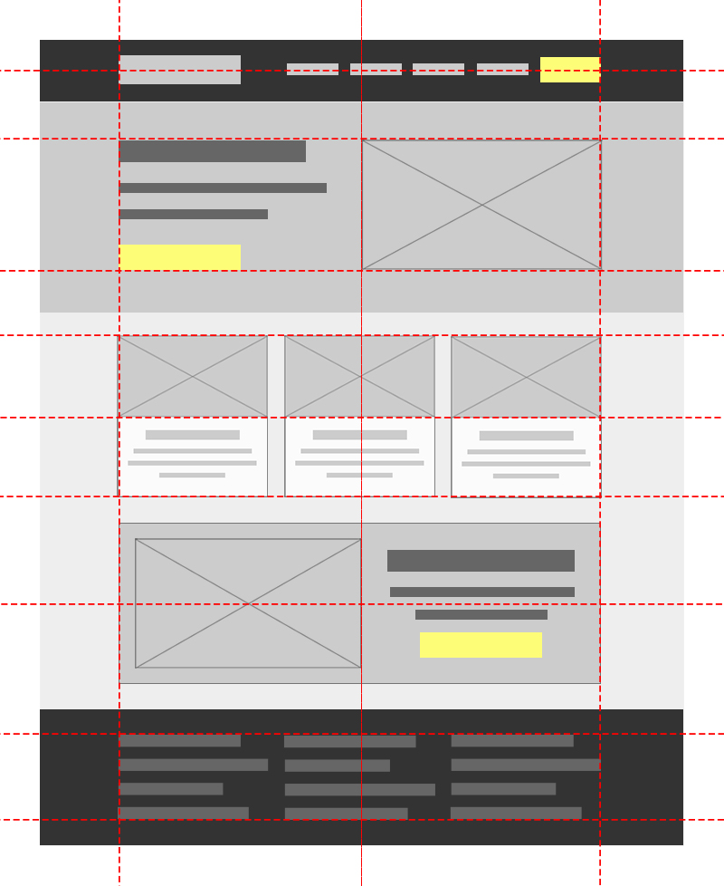
Alignment
Alignment In web design
All kinds of alignments:
https://uxengineer.com/principles-of-design/alignment
https://happyaddons.com/alignment-in-web-design/
Source: https://uxengineer.com/principles-of-design/alignment

Slide 40
Alignment
How to apply this in UI/UX design:
Ensure that groups of web elements are contained within containers to keep content confined within defined spaces.
Utilize principles of columns and rows to organize layouts containing various web elements such as text, images, and navigational elements. Use CSS grid frameworks like Bootstrap, Foundation, or Tailwind to streamline grid usage.
Apply proportional and consistent spacing between columns (gutters) in every web page layout. This practice facilitates the alignment of grouped elements, leveraging symmetric column and asymmetric grid structures to align your content proportionally.
For consistency, always use the same type of text alignment, especially for related text elements. Left alignment is a standard practice in languages that read from left to right.
Always align groups of web elements within the grid borders. Grid borders divide the page into vertical bars and serve as a guide for placing your content.

Slide 41
Emphasis
Emphasis means highlighting certain design elements so that they stand out. When readers look at the design, they automatically see the highlighted feature.

Slide 42
Emphasis
Emphasis In web design
Notes:
As you may have noticed right away, the white circle is greatly emphasized compared to the other grey circles, which are many shades darker.

Slide 43
Emphasis
How to apply this in UI/UX design:
1. Increase size / weight
Let’s get the obvious out of the way. The larger, bolder something is, the more attention it attracts.
To add emphasis to text, you can increase either the text size or font weight.
2. Change color
In general, the brighter and bolder the color, the more it will stand out.
To easiest way is to use your brand colors to accent the most important parts of your app. If you're using mostly neutral colors, you can create emphasis by varying between darker and lighter shades.

Slide 44
Emphasis
How to apply this in UI/UX design:
3. Break continuity
We are conditioned to see patterns and continuity when using a product. So if you can break the pattern in any way, things will naturally stand out.
4. Add white space
Your eyes are naturally drawn to areas with more white space. Surrounding an important element with white space makes it stand out more.
5. Emphasize by de-emphasizing
When everything is a priority, then nothing is. Similarily, emphasis is relative. If everything on the page is screaming for attention, nothing stands out. A more elegant approach is to de-emphasize less important elements. You can do so by reducing opacity, using lighter colors, or making them smaller.

Slide 45
Balance
A satisfying arrangement or proportion of design elements.
Balance occurs when there is an equally distributed (but not necessarily symmetrical) amount of visual signal on both sides of an imaginary axis going through the middle of the screen.
This axis is often vertical but can also be horizontal.

Slide 46
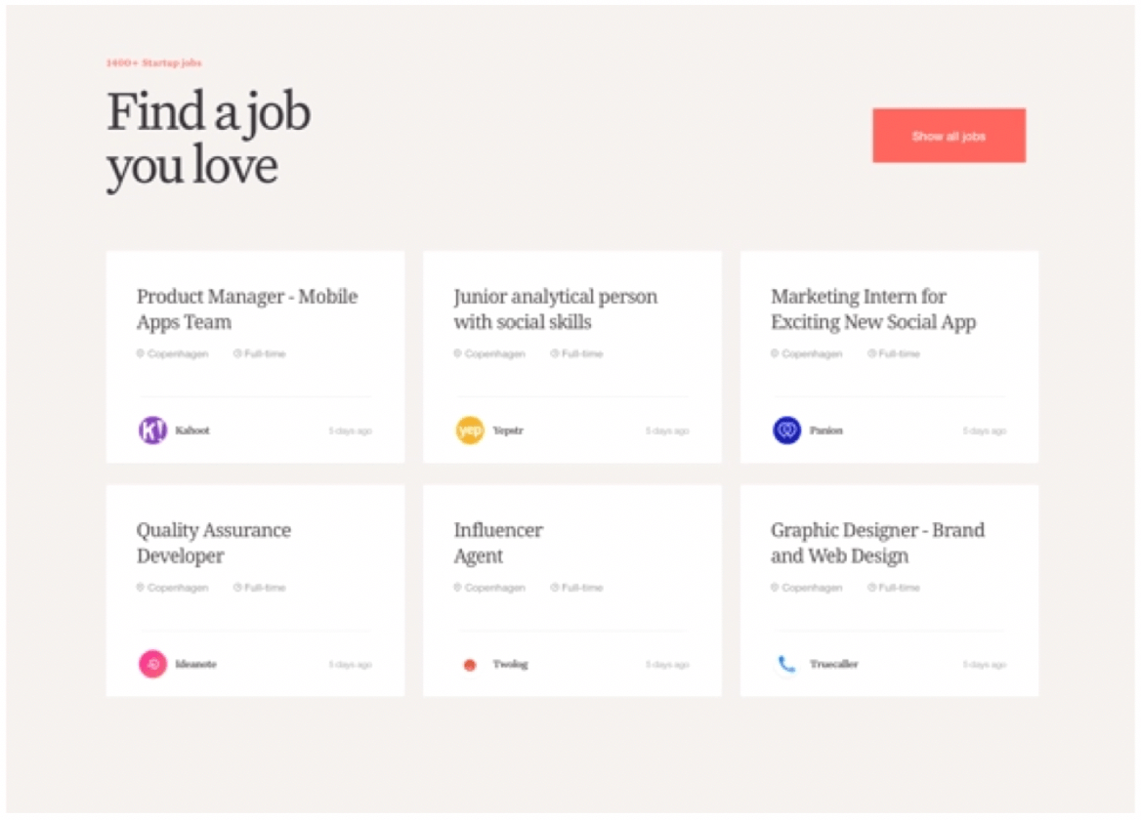
Balance
Balance In web design
Source: https://dribbble.com/
Notes:
The Hub Style Exploration: The composition feels stable, which is especially appropriate when you’re looking for a job you love. The balance here is symmetrical. If you were to draw an imaginary vertical axis down the center of the website, elements are distributed equally on both sides of the axis.

Slide 47
Balance
How to apply this in UI/UX design:
To create balance, you have to find a way to balance the elements in your design. The best way to do this is by using negative space (white space) and by making sure your elements are visually similar in size and weight.
For example, if you have a large image that takes up much of the page, then make sure that there are at least two other elements on the page that are smaller than it.
If all of your elements are large, then people won’t know where to focus their attention because they’ll be spread out across different sizes and weights of objects.

Slide 48
Contrast
Contrast is another key principle of design that helps set apart important elements from the rest of the page.
It allows users to focus on what matters most without being distracted by other things around it — which is especially important on mobile devices where screens are smaller than desktop monitors and less capable of generating lots of contrast on their own.
Contrast also helps guide users through a page by providing visual cues about where they might want to go next (ex: call to action, hyperlinks, likewise).

Slide 49


Contrast
Contrast In web design
Use sufficient color contrast ! https://webaim.org/resources/contrastchecker/
Source: https://elementor.com/blog/contrast-web-design/

Slide 50
Contrast
How to apply this law in UI/UX design:
Color Contrast: The difference in light between the foreground (text or elements) and background, ensuring readability and emphasis.
Size Contrast: Using varying sizes to highlight key elements, create depth, and establish hierarchy.
Space Contrast: Also known as negative space, it surrounds elements to enhance focus and clarity.
Foreground vs. Background Contrast: Defines the visual relationship between an element and its background, which may change dynamically in web design.
Shape Contrast: Making elements stand out by varying their physical shape to guide attention.
Elements Contrast: Mixing different media (photos, illustrations, sketches) to impact the website’s aesthetics and messaging.

Slide 51
Repetition
Repetition is the practice of using the same or similar elements multiple times to reinforce ideas and organize content.
Our brains are made to recognize patterns. Repeating elements within a design creates consistency and familiarity — key components of a pleasant user experience.

Slide 52
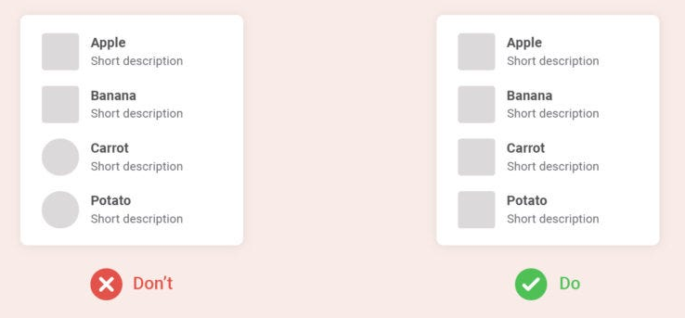
Repetition
Repetition In web design
Source: https://bootcamp.uxdesign.cc/

Slide 53
Repetition
How to apply this law in UI/UX design:
Typography & Colors: Use consistent fonts, sizes, and brand colors.
UI Components: Standardize buttons, icons, and form fields.
Layout & Spacing: Maintain uniform spacing and grid structures.
Animations & Feedback: Apply consistent hover effects and interaction responses.

Slide 54
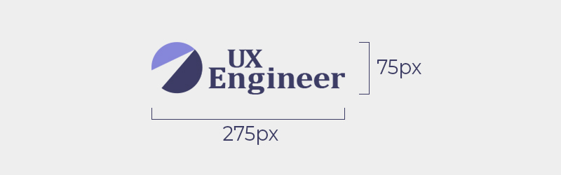
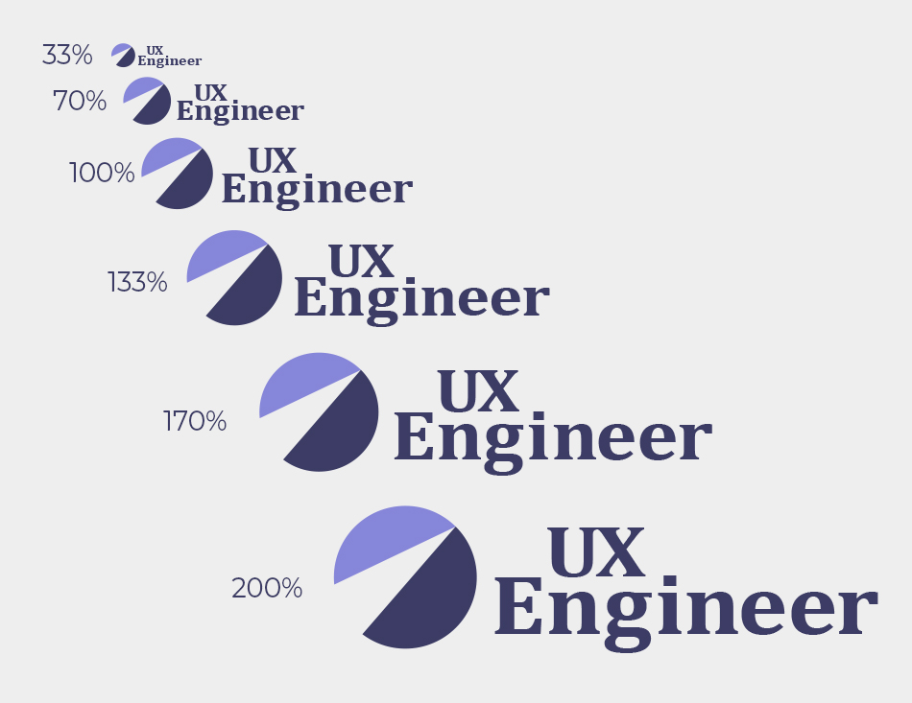
Proportion
Proportion is the harmonious relationship between two or more parts that make up a whole. Most typically, proportion is defined by the scale of elements, in relation to each other.
Size vs Scale vs Proportion
Size is the actual dimensions of an element,
often measured in px, pt, em, rem etc.
Scale is the relative dimensions of an element, often measured by percentages or multiples.
For example, an element can be scaled to be bigger or smaller than it’s original size.
For example, the size of this logo is 75px tall and 275px wide.
Source: https://uxengineer.com/principles-of-design/proportion

Slide 55
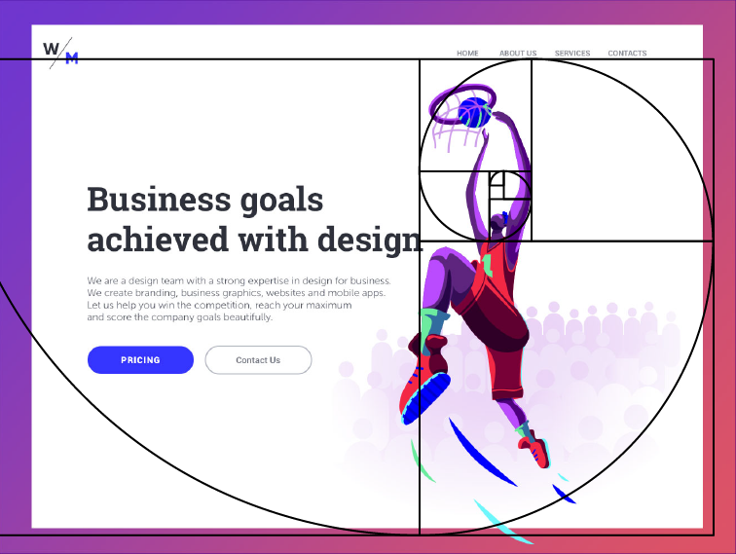
Proportion
Proportion In web design
Golden ratio in design
Effective composition is a core part of a design. All the elements need to work together to maximize a pleasant experience.
Moreover, each separate element, even the small one like an icon, has to be created in a harmony within itself.
The golden ratio has a positive influence on visual perception, the reason why many graphic and UI designers apply it at their workflow.
Source: https://uxplanet.org/golden-ratio-bring-balance-in-ui-design-765c954f0ff9

Slide 56
Proportion
How to apply this in UI/UX design:
Use a grid system: By using a grid, you can ensure that your elements are proportionally spaced and aligned, which creates a more cohesive layout.
Use a consistent scale: This means that related elements should be sized relative to each other, creating a sense of visual unity. For example, when establishing a typography hierarchy, you can make the headings 1.5 to 2 times larger than the body text.

Slide 57
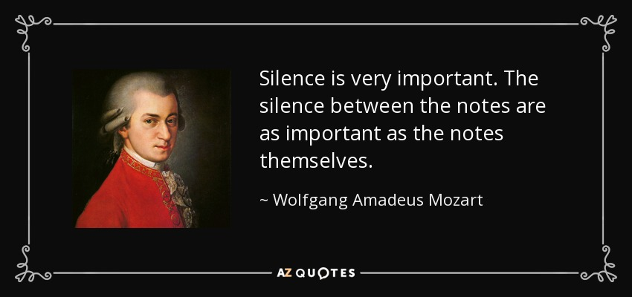
White Space
Whitespace (or “negative space”) is an empty space between and around elements of a page. Although many may consider it a waste of valuable screen estate, whitespace is an essential element in design.
White space helps to
improve the legibility
design an organised layout
create sense of hierarchy
guide user’s attention
emphasize important information
Source: https://www.azquotes.com /
Notes:
+ We refer to micro and macro white space in UI design.
- Micro white space refers to the small spaces between individual elements, such as text and images.
- Macro white space refers to the larger spaces between sections or groups of elements, such as between paragraphs or sections of a page.

Slide 58
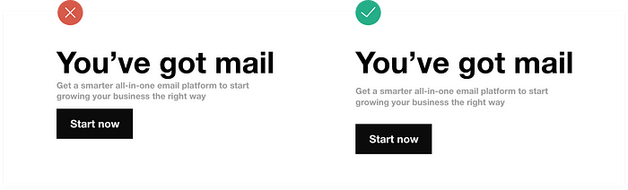
White Space
White space in web design:
Source: https://medium.com/

Slide 59
White Space
How to apply this in UI/UX design:
Leave spaces empty
Remove borders (if unnecessary on shapes, icons and other elements)
Enlarge the background image
Use a colored background
Space the letters
Use padding
Add a border (around central elements like text and images)
Make one aspect of your design prominent

Slide 60
Visual Hierarchy
Visual hierarchy is the way your website or application uses contrast, size, color, and other factors to give some elements more important than others.

Slide 61
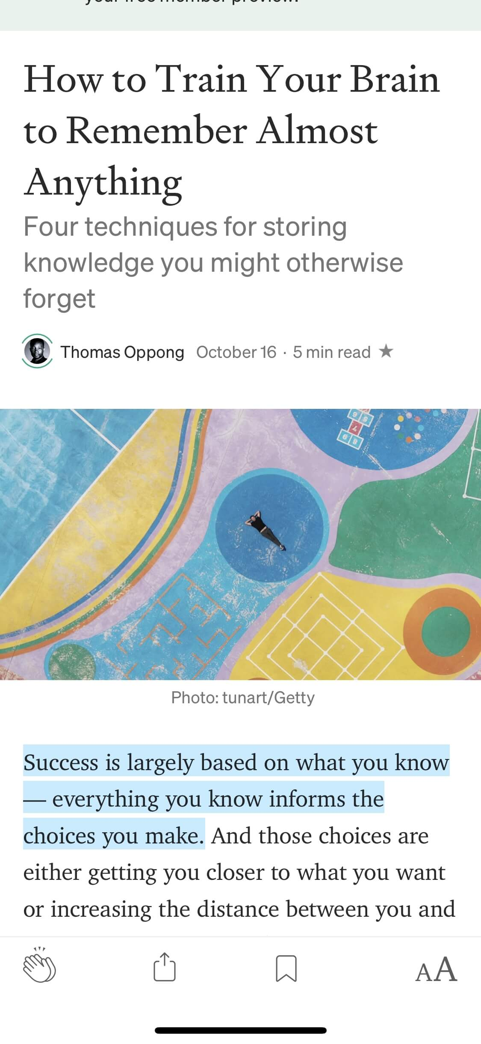
Visual Hierarchy
Visual Hierarchy in web design:
Medium mobile app: There is a clear visual hierarchy of title, subtitle, and body text.
Each component of the article is in a type size equal to its importance.
Source: https://www.nngroup.com/articles/principles-visual-design/

Slide 62
Visual Hierarchy
How to apply this in UI/UX design:
Define Interface Goals: Clearly establish design objectives and highlight key elements to ensure a structured and user-friendly experience.
Use Size and Typography: Different font sizes and styles help create a clear visual hierarchy, making navigation intuitive and emphasizing important content.
Leverage Color and Contrast: Strategic use of colors and contrast directs attention to key elements, improving readability and user guidance.
Organize Information Effectively: A logical layout, whether vertical (e.g., Netflix’s featured content) or horizontal (e.g., navigation tabs), ensures users find what they need effortlessly.

Slide 63
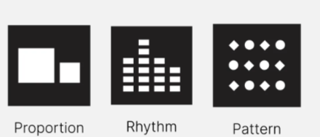
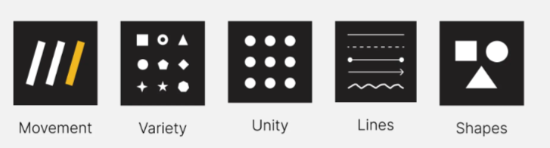
And many more…
Proportion, Rhythm, Pattern, Movement, Variety, Unity, Line, Shapes
Source: https://medium.com/
Notes:
Proportion Proportion refers to the relative size and scale of elements in a design, ensuring visual balance and a natural look.
Rhythm Rhythm is the repeated use of elements in a pattern or sequence to create visual movement and harmony.
Pattern Pattern is the repetition of visual elements like shapes, lines, or colors to add consistency and unity to a design.
Movement Movement guides the viewer’s eye through a design by using direction, flow, or implied motion between elements.
Variety Variety introduces different elements, styles, or visual contrasts to maintain interest and prevent monotony in a design.
Unity Unity ensures all design elements work together cohesively to create a consistent and harmonious composition.
Line A line defines space, outlines shapes, and creates structure or emphasis in a design, whether straight, curved, thick, or thin.
Shape Shape refers to enclosed areas created by lines or curves that define objects and contribute to the visual structure of a design.

Slide 64
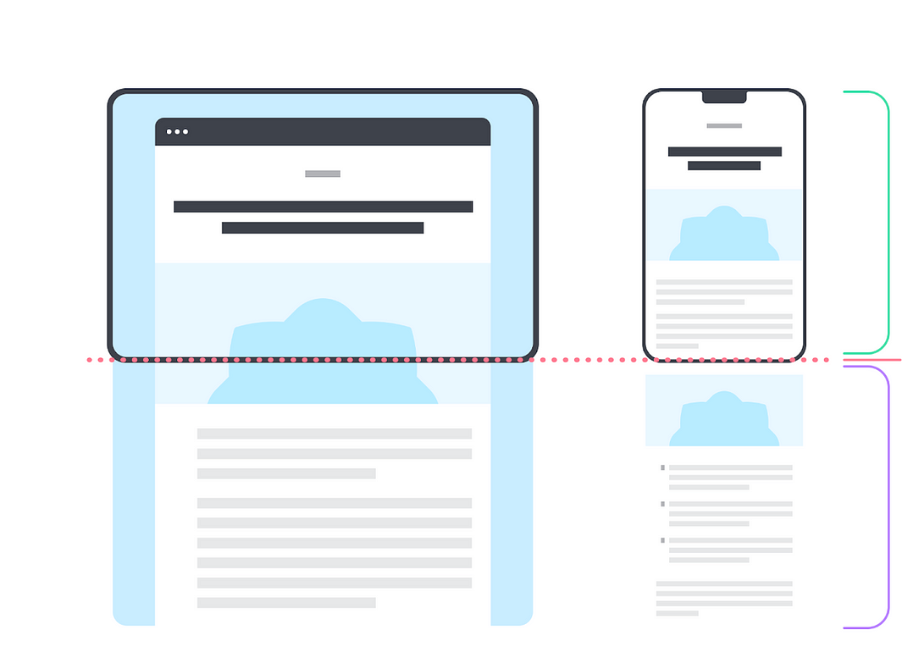
Above the fold
‘’Fold” is a term commonly used in ergonomics and web design. It refers to the virtual line that separates the content visible on a web user's screen from that visible only via the scroll bar.
Above the fold (ATF) is the part of a webpage that you can see without scrolling down.
Make interactions visible.
Above the Fold
Fold
Below the Fold
Source: semrush.com

Slide 65
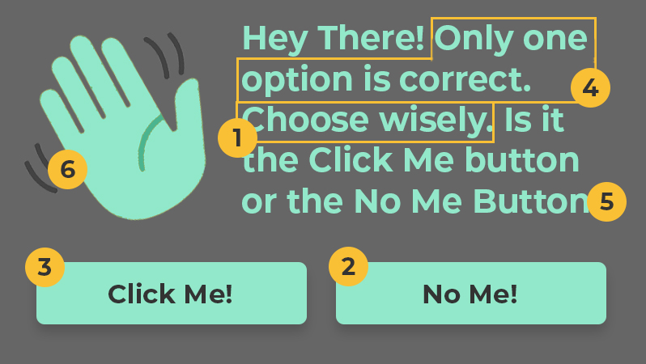
EXERCISE
Let’s assess where emphasis could be applied or reduced to improve the design
Source: https://uxengineer.com
Notes:
The call-to-action will be to “Choose Wisely,” making it immediately clear what the user should do.
The primary button will be the “No Me” button. We’ll make this the second most emphasized element, so the user can can have confidence that it’s the “right choice.”
The secondary button will be the “Click Me” button. This button will have less emphasize to make it clear that it’s not as important as the primary button.
Next, we’ll make sure the reader knows “only one option is correct” by giving it more emphasis than the remaining text.
The remaining text is merely provided for more context. Since it’s not as important as the previous elements it will be toned down a bit.
Finally, the waving hand icon is the least important element. If anything, it only serves to help communicate the message subconsciously. Therefore, it will be muted to fade into the background.

Slide 66
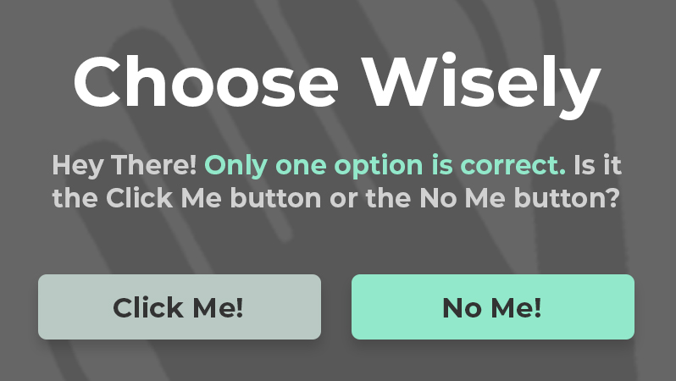
EXERCISE
A proposal
Source: https://uxengineer.com

Slide 67
The Psychology Principles in UI/UX Design
Psychology has an important role in designing the user experience.
By understanding how different psychology principles influence human behaviour, you can design your products to elicit specific responses and actions from your users.

Slide 68
Hick’s Law
Hick's Law (or the Hick-Hyman Law) states that the more stimuli (or choices) users face, the longer it will take them to make a decision.
RT = a + b log₂ (n)
Time It
Takes to
Make a
Decision
Hick’s Law
RT is the Reaction Time, (n) is the number of stimuli, "a" and "b" are constants
Number of Choices

Slide 69
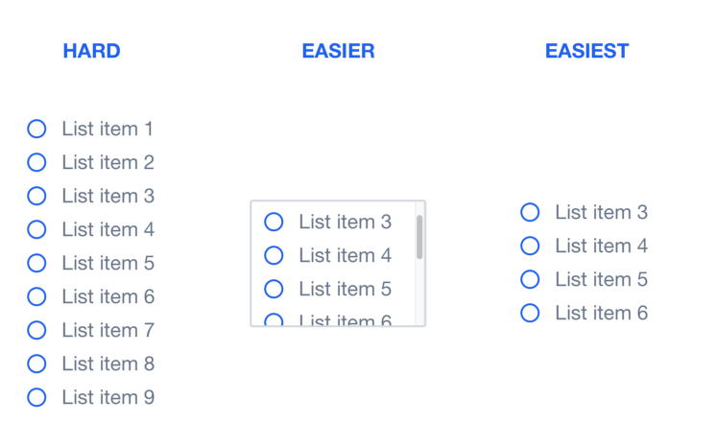
Hick’s Law
Hick’s Law in web design:
Source: https://malikachatlapalli.medium.com/improve-your-interaction-design-with-6-principles-d5d2533911e8
Notes:
In this visual above, on the left the user has many options to choose from and will take longer to decide. You can make this easier by limiting the number of options in view, but the best solution is to limit the total number of options.

Slide 70
Hick’s Law
How to apply this law in UI/UX design:
Minimize choices when response times are critical to reduce decision time.
Break down complex tasks into smaller steps to reduce cognitive load.
Use filters for large numbers of products.
Take care not to simplify to the point of abstraction.

Slide 71
Gestalt Principles of Visual Perception
There are various psychology laws in design. Gestalt psychology, founded in the early 20th century, revolves around the idea that "the whole is greater than the sum of its parts." Our brains naturally organize and interpret visual information in a way that allows us to perceive meaningful patterns.
The Gestalt Principles are a set of psychological concepts that explain how humans perceive and organize visual elements.
These principles help designers create more effective and intuitive designs by understanding how users naturally group and interpret information.

Slide 72
Why Are Gestalt Principles Important in Design?
Improve user experience (UX) by making interfaces more intuitive.
Enhance visual hierarchy and readability.
Guide users’ attention to important elements.
Create cohesive and aesthetically pleasing layouts.
Gestalt principles are widely used in UI/UX design, branding, and graphic design to ensure that information is presented clearly and effectively.

Slide 73
Law of Proximity - Key Gestalt Principles
Elements that are close to each other are perceived as related or grouped together.
This is perceived to be one
Group and the components
Somehow related to each other
We perceive two groups here,
and understand that there are
differences between them

Slide 74
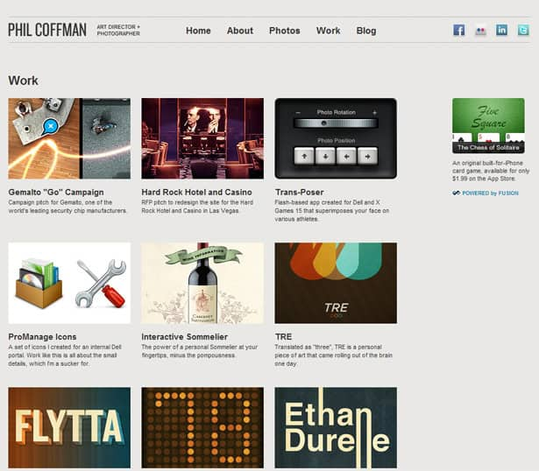
Law of Proximity - Key Gestalt Principles
Law of Proximity In web design
Source: https://webdesignerdepot.com/

Slide 75
Law of Proximity - Key Gestalt Principles
How to apply this law in UI/UX design:
Group related elements closely. Place buttons, icons, or text fields that belong together near each other to indicate their relationship.
Maintain consistent spacing between related elements and increase space between unrelated groups to show separation.
Avoid clutter and ensure there’s enough space between different groups for clarity.
In long forms, group fields by related categories (e.g., personal details, payment info) to make the form easier to follow.
Use proximity to create hierarchy in navigation menus, product listings, or informational layouts.

Slide 76
Law of similarity - Key Gestalt Principles
Objects that share similar characteristics (color, shape, size) are seen as belonging together.

Slide 77
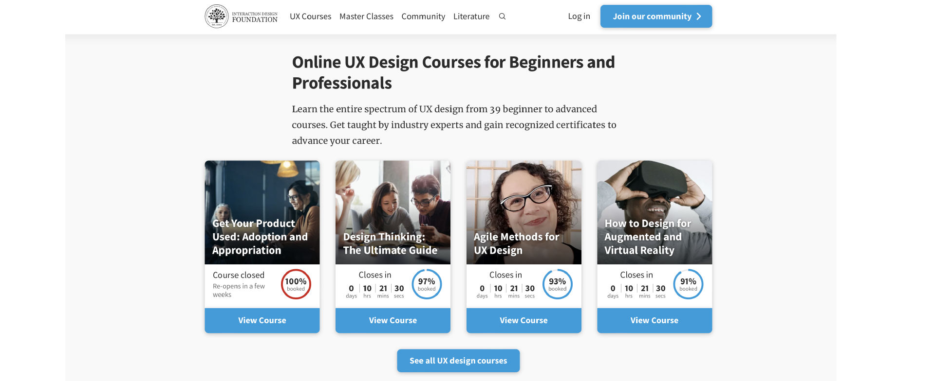
Law of similarity - Key Gestalt Principles
Law of similarity – In web design
Source: https://www.interaction-design.org/
Notes:
When items, objects or elements share superficial characteristics, we perceive them as grouped. We can see the similarity principle in branding and design system guidelines.

Slide 78
Law of similarity - Key Gestalt Principles
How to apply this law in UI/UX design:
Style all buttons or links that perform similar functions the same way (e.g., same color, size, and shape).
Use the same typography (font, size, and style) for related text elements (e.g., all headings, subheadings) to create a cohesive look.
Repeat visual styles: apply similar colors, shapes, and patterns to related elements across different sections of the UI.
Highlight differences: to make specific actions stand out, use contrasting styles (e.g., a unique color for a CTA button among similarly styled buttons).
Use visual cues: in complex interfaces, use icons, colors, or shapes consistently to indicate similar actions or functions.

Slide 79
Law of Common Regions - Key Gestalt Principles
Close to Law of similarity
The Law of Common Regions refers to the tendency of our brains to group elements together when they are located within a shared boundary or enclosure.
Notes:
Adding borders or other visible barriers is a great way to create a perceived separation between groups of objects—even if they have the same proximity, shape, color, etc.

Slide 80
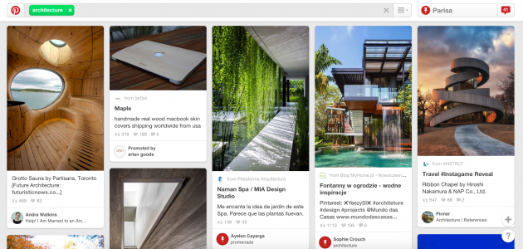
Law of Common Regions - Key Gestalt Principles
Law of Common Regions– In web design
Source: https://www.pinterest.com/
Notes:
In the example from Pinterest below, the common region principle is used to separate each pin—including its photo, title, description, contributor, and other details—from all the other pins around it.

Slide 81
Law of Common Regions - Key Gestalt Principles
How to apply this law in UI/UX design:
Use containers or boxes: group related elements, such as form fields or products, in clearly defined containers or regions.
Leverage background colors to visually group content and separate it from other sections.
Apply borders and shadows to indicate that certain elements belong together.
Create distinct sections: separate different categories of information with whitespace or visual dividers to improve scannability.
Organize information visually: apply the principle when laying out dashboards, lists, or forms to help users process content more quickly.

Slide 82
Law of symmetry - Key Gestalt Principles
Symmetrical elements are perceived as part of the same group.
If the mind perceives 2 symmetrical elements that are not connected, it connects them to form a coherent shape.
[ ] { } [ ]
When you look at these brackets, you tend to see 3 pairs of brackets rather than 6 individual elements.

Slide 83
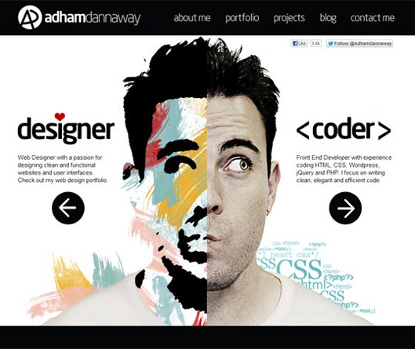
Law of symmetry - Key Gestalt Principles
Law of symmetry – In web design
Source: https://guo-chen.medium.com/

Slide 84
Law of symmetry - Key Gestalt Principles
How to apply this law in UI/UX design:
Align elements symmetrically: place navigation bars, buttons, or form fields in symmetrical layouts to create balance and harmony.
Mirror design across screens. Ensure consistency in layouts between different pages or app screens using symmetrical patterns.
Maintain visual balance: avoid placing too much weight (large elements, bold colors) on one side of the screen; distribute them evenly.
Use symmetrical icons or buttons to create a balanced and professional look.
Introduce asymmetry with caution. If you want to introduce visual tension or dynamism, use asymmetry in small doses, keeping the overall design balanced.

Slide 85

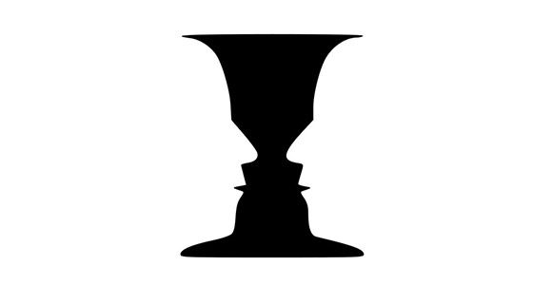
Figure and Ground - Key Gestalt Principles
The brain distinguishes between foreground and background elements.
Source: https://www.interaction-design.org/
Source: https://www.toptal.com/designers/ui/gestalt-principles-of-design

Slide 86
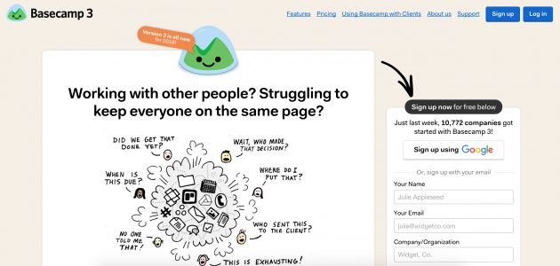
Figure and Ground - Key Gestalt Principles
Figure and Ground In web design
Source: https://www.usertesting.com/blog/gestalt-principles
Notes:
The Basecamp homepage has a bunch of graphics, text, forms, and other information. And because of the figure-ground principle, you can immediately tell that you should focus on the content in the white foreground areas.

Slide 87
Figure and Ground - Key Gestalt Principles
How to apply this law in UI/UX design:
Align elements symmetrically: place navigation bars, buttons, or form fields in symmetrical layouts to create balance and harmony.
Mirror design across screens. Ensure consistency in layouts between different pages or app screens using symmetrical patterns.
Maintain visual balance: avoid placing too much weight (large elements, bold colors) on one side of the screen; distribute them evenly.
Use symmetrical icons or buttons to create a balanced and professional look.
Introduce asymmetry with caution. If you want to introduce visual tension or dynamism, use asymmetry in small doses, keeping the overall design balanced.

Slide 88
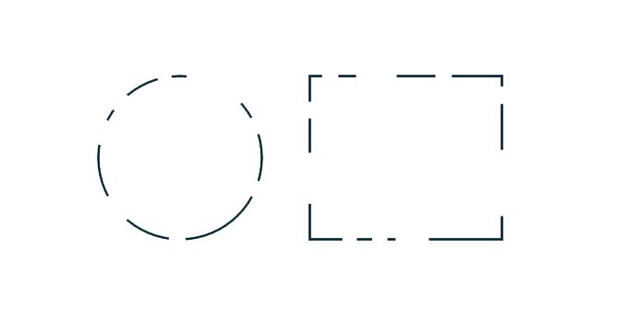
Law of Closure - Key Gestalt Principles
The mind fills in gaps to complete a visual pattern or shape
Without this principle, we would only perceive a set of discontinuous lines, without perceiving the form as a whole.
Notes:
The Gestalt principle of Closure is especially useful in UI/UX design for creating clean, minimalist designs without sacrificing comprehension. Designers can imply elements rather than explicitly show every detail, allowing users to engage with the design on a more intuitive level
Law of closure is commonly applied in logo design, where incomplete shapes or outlines are perceived as whole objects due to the mind’s tendency to fill in the gaps. For instance, the IBM logo is one of the famous Gestalt principles examples in action as it uses a series of horizontal lines that our brains interpret as letters despite the spaces in between.

Slide 89


Law of Closure - Key Gestalt Principles
Law of Closure In web design
Source: https://icon-icons.com/
Notes:
The Basecamp homepage has a bunch of graphics, text, forms, and other information. And because of the figure-ground principle, you can immediately tell that you should focus on the content in the white foreground areas.

Slide 90
Law of Closure - Key Gestalt Principles
How to apply this law in UI/UX design:
Use implied shapes. Suggest complete forms with partial outlines or borders, encouraging users to mentally fill in the gaps.
Create minimalist icons that use negative space to imply completeness, reducing visual clutter while maintaining clarity.
Simplify complex forms into simpler, suggestive forms that users can easily recognize and complete in their minds.
Use in loading animations. Create loading indicators or progress bars where incomplete circles or bars can imply continuity and completion.
Engage users’ imagination and let them interpret and complete visual elements rather than explicitly showing everything.

Slide 91
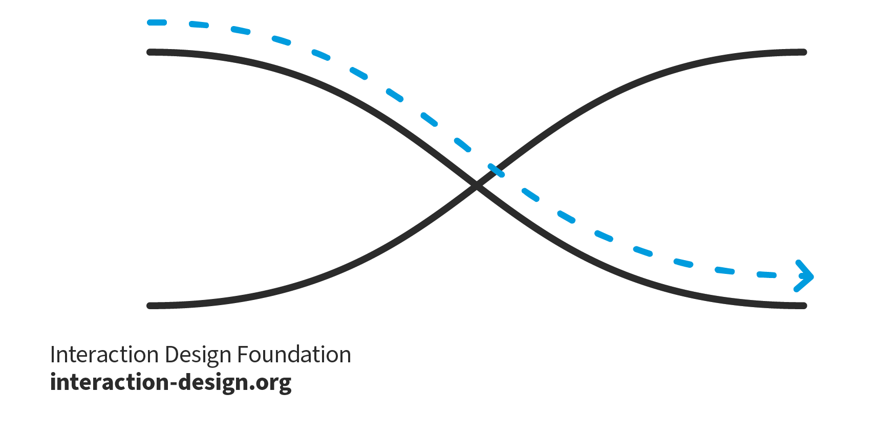
Law of Continuity - Key Gestalt Principles
The eye follows lines, curves, or patterns smoothly rather than seeing them as separate elements.
Notes:
The Gestalt principle of continuity suggests that our minds prefer to perceive continuous, unbroken lines or patterns, even when they are interrupted. When elements are arranged along a path or curve, the eye naturally follows that path, creating a sense of flow. This principle is widely used in design to guide users’ attention through a layout in a smooth, uninterrupted manner. For example, in web or app design, elements like arrows, lines, or visual cues that align along a curve or trajectory can direct users’ focus from one section to another, enhancing navigation and storytelling.
In the image above, for example, the red dots in the curved line seem to be more related to the black dots on the curved line than to the red dots on the straight horizontal line. That’s because your eye naturally follows a line or a curve, making continuation a stronger signal of relatedness than the similarity of color.

Slide 92
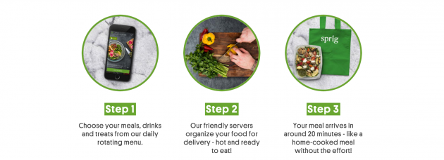
Law of Continuity - Key Gestalt Principles
Law of Continuity In web design
Source: https://www.usertesting.com/blog/gestalt-principles

Slide 93
Law of Continuity - Key Gestalt Principles
How to apply this law in UI/UX design:
Use visual cues: incorporate lines, arrows, or curves to direct users’ attention and guide them through a specific flow or process in your interface.
Align elements along a path: arrange text, buttons, or images in a linear or curved sequence that encourages users to follow the path naturally.
Create seamless navigation: design menus or navigation bars that visually lead users from one section to another without abrupt changes or distractions.
Use gradients or fading effects: apply subtle visual transitions, such as gradients or fading, to create a smooth flow between different sections or states in the interface.
Maintain visual hierarchy to ensure that important elements, like CTAs or important content, are positioned along the natural flow of the design, guiding users’ eyes to them effortlessly.

Slide 94

Common Fate - Key Gestalt Principles
Objects moving in the same direction or at the same speed are perceived as related.
Source: Gizmodo via https://www.usertesting.com/blog/gestalt-principles

Slide 95
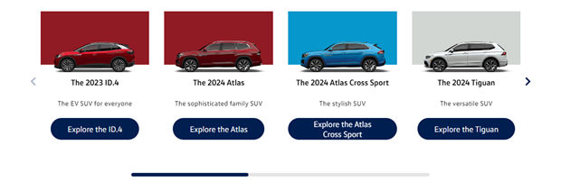
Common Fate - Key Gestalt Principles
Common Fate In web design
Volkswagen utilizes carousels to showcase their new releases.
© Volkswagen, Fair Use
Source: https://www.interaction-design.org/

Slide 96
Common Fate - Key Gestalt Principles
How to apply this law in UI/UX design:
Animate Related Elements : Sync animations for grouped items (e.g., dropdowns, tooltips).
Use Directional Cues : Guide users with motion (e.g., progress indicators).
Group via Movement : Elements moving together appear related (e.g., carousel cards).
Enhance Hover Effects : Trigger animations for connected elements (e.g., buttons + icons).

Slide 97

The Von Restorff Effect
The Von Restorff effect (also known as the isolation effect) predicts that when multiple similar objects are present, the one that differs from the rest is most likely to be remembered!
This is the main reason why all call-to-actions (CTAs) look different from the rest of the action buttons on a site or application!
Source: https://www.onepager.com/

Slide 98
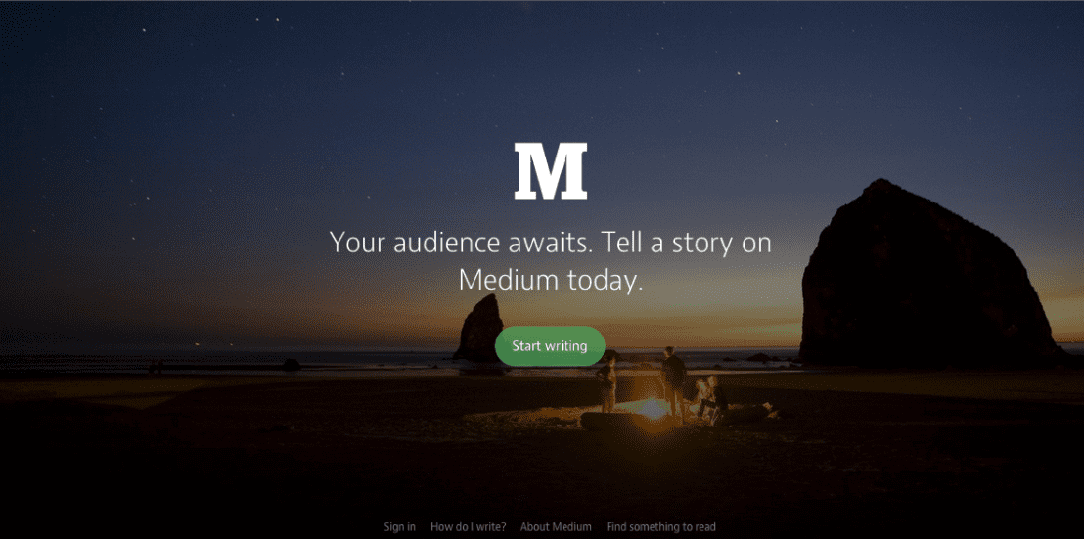
The Von Restorff Effect
The Von Restorff Effect In web design
Medium uses a green CTA button that contrasts with the background colors to draw attention to it.
Source: www.medium.com

Slide 99
The Von Restorff Effect
How to apply this law in UI/UX design:
Use Contrast Wisely : Make the target highlight unique by ensuring it uses different shapes or colours or sizes from other elements. But don’t overdo it. Multiple prominent items within a design will confuse users.
The highlight should focus exclusively on one element: Multiple attention-seeking elements will prevent the effect from being noticeable. The vital element should receive your primary attention.
Test and Optimize : By employing A/B testing, companies can locate optimal design choices. To determine which elements work best, you should use various colour combinations, size variations, and placement arrangements directed at your audience.

Slide 100
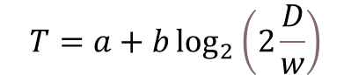
Fitts’ Law
Fitts’ Law proposes that the time taken to move to a target area is a function of the size of the target and distance to the target.
The law suggests placing target buttons closer to expected mouse locations and making them larger to decrease interaction time. This concept is important in web design because the time required to take a desired action affects conversion rates and any additional time is a risk of losing a potential customer
Time
Distance
$$T=a+b\log_{2}\left(2\frac{D}{w}\right)$$
Coefficients
Width

Slide 101
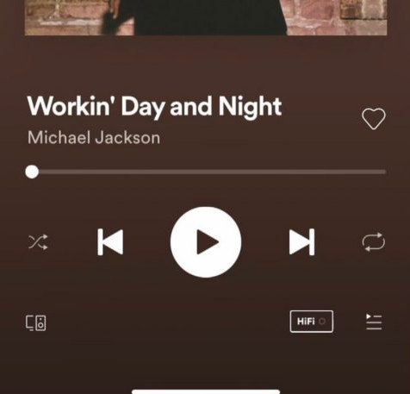
Fitts’ Law
Fitts’ Law In web design
For example, Spotify makes it easier to press “Play” than any other button.
Source: Spotify - Web Player: Music for everyone

Slide 102
Fitts’ Law
How to apply this law in UI/UX design:
Larger Targets: Make interactive elements big enough for easy clicks, especially for touchscreens.
Reduced Distance: Keep frequently used controls close to main interaction areas, like the bottom of mobile screens.
Edge & Corner Placement: Use screen edges and corners for key controls to enhance accessibility.
Grouping: Place related elements together to streamline interactions and improve usability.
Feedback: Provide immediate visual or interactive confirmation upon interaction.
Accessibility: Ensure targets are large, high-contrast, and well-positioned for diverse users and devices.

Slide 103
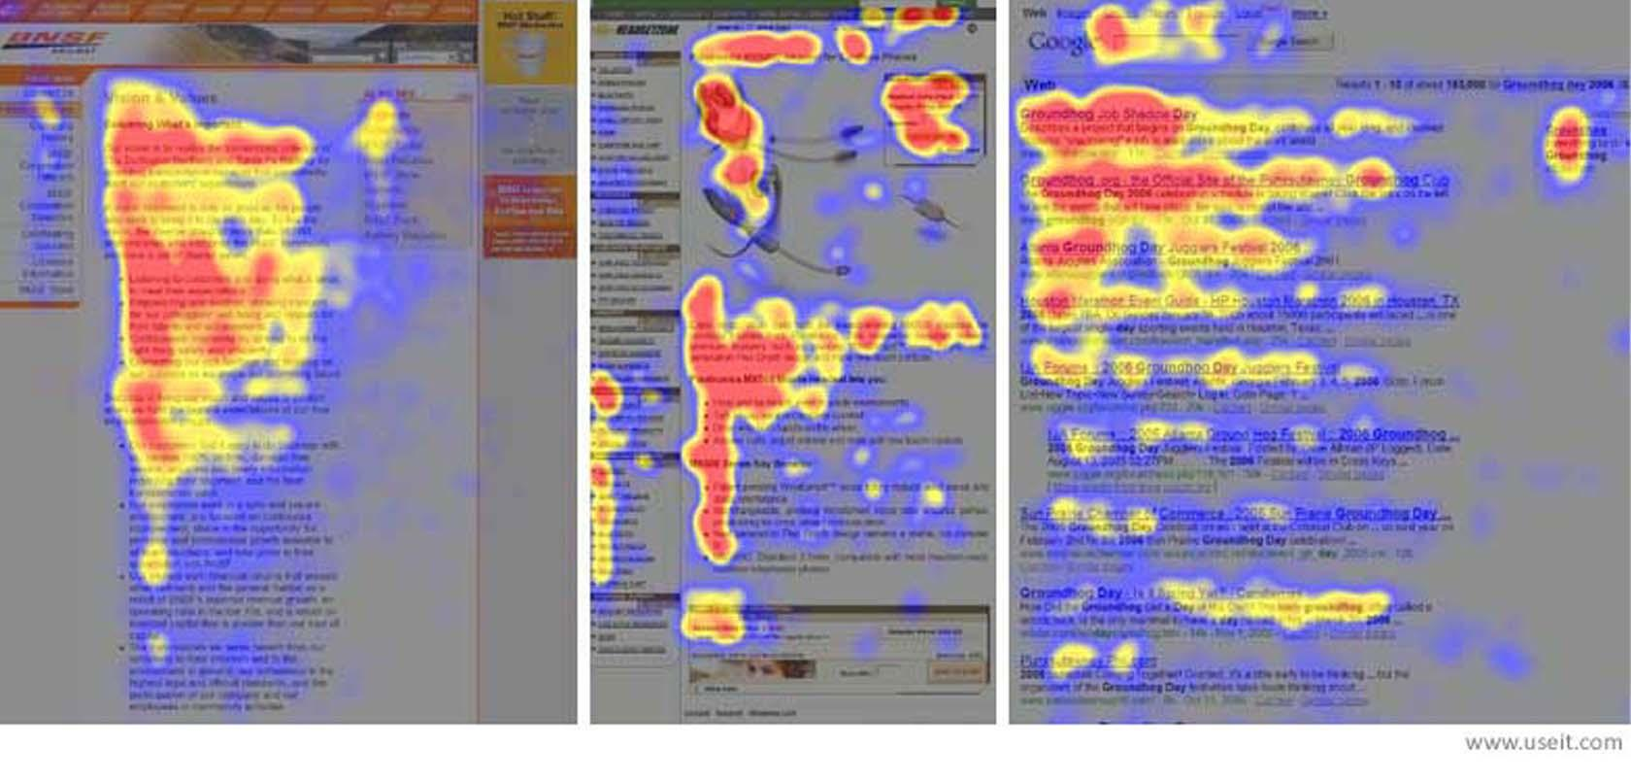
What Eye-Tracking reveals
Eye tracking is a technique to use specialized technology to track—and analyze—where users look on a digital interface and for how long.
Designers use this data to understand user attention and behavior—and optimize how they place elements like buttons and menus to enhance the user experience.
The Nielsen Norman group F-pattern heat maps from eye tracking studies
Source: https://uxplanet.org/8-ways-to-reduce-cognitive-load-part-2-4b0f9d8ef5ad

Slide 104
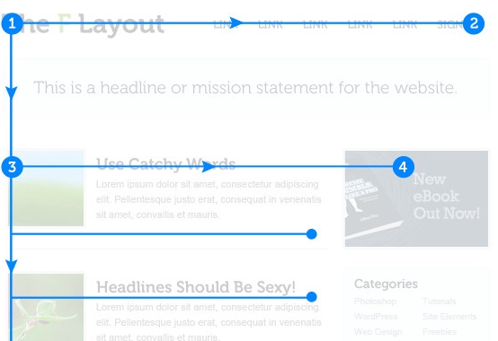
F Pattern
F Pattern describes the most common scanning patterns of the user's eye when it comes to content blocks.
F for fast. This is how users read your content. In a matter of seconds, their eyes move at incredible speed over the pages of your website.
Source: https://medium.com

Slide 105
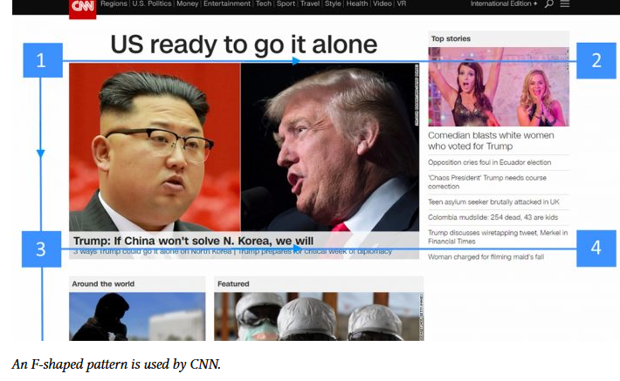
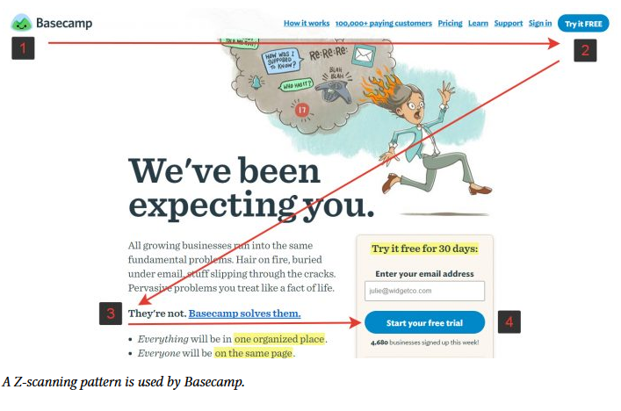
F vs Z patterns
F Pattern
Z Pattern
Source: https://medium.com

Slide 106
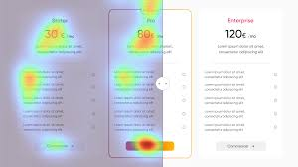
Heatmap - Attention Insight
Attention Insight is a predictive analytics tool that evaluates how users visually perceive a design before it even goes live. It uses advanced algorithms to simulate where users' attention is likely to be directed when viewing a page.
https://chromewebstore.google.com/detail/attention-insight/kckakcdglnklfekbjcghcogpohmdammg

Slide 107
EXERCISE
User Inyerface is a hardcore and funny game where you have to fight your way through an incredibly dumb and complicated interface as quickly as possible. You will forever remember these mistakes in design. It`s an emotional design, but emotion is cringe.
https://userinyerface.com/
Notes:
Try to complete the tasks on this deliberately frustrating website. Observe how confusing design, unclear guidance, and visual overload increase your cognitive workload.
Ask participants to visit the website and attempt to complete the form. Then, debrief with them:
What made the experience difficult?
How did they feel during the task?
Can they identify elements that increased their cognitive load? (bad hierarchy, misleading buttons, intrusive pop-ups)
This exercise is a great illustration of how poor usability principles can negatively impact the user experience, leading to frustration, errors and increased mental effort.

Slide 108
Usability Principles
As we said first, principles of design and principles of ergonomics are closely related.
Let's take a look at the ergonomic approach, repeating certain principles with other examples
Notes:
Slide Purpose Introduce the overall theme: the core principles of usability (sometimes called ergonomics) in digital product design.
Good usability significantly impacts project success and user satisfaction.
Well-designed products can reduce frustration, improve adoption, and enhance brand reputation.

Slide 109
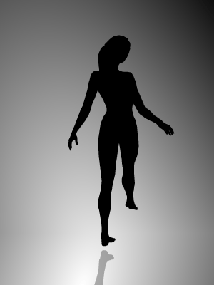
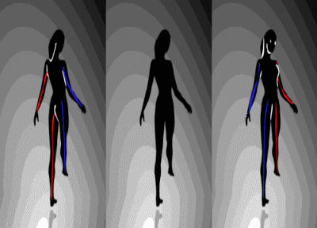
How we focus
Source: https://www.braingymmer.com/en/blog/brain-illusion/
Notes:
Slide Purpose This is an optical illusion showing two human silhouettes in motion. Depending on how you focus, you may see them turning clockwise or counterclockwise. This is a great way to illustrate how our perception can vary depending on visual cues and how easily we can misinterpret information. In UX, this reminds us that users might not see or interpret an interface element the same way.

Slide 110
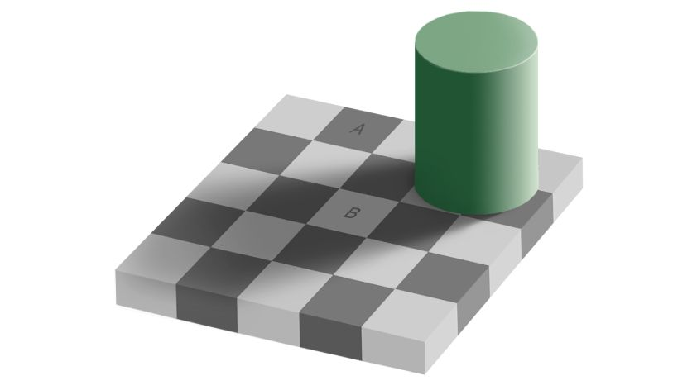
Source: https://www.newscientist.com/
Notes:
Slide Purpose This image shows another famous visual illusion. Square A and square B appear to be different shades of grey, but they are actually the same color. The surrounding context, like the shadow and the pattern, tricks our brain. This demonstrates how visual context influences perception. In interface design, we need to be aware that contrast, shadows, and environment can mislead the user.

Slide 111


787878
Source: https://www.newscientist.com/
Notes:
Slide Purpose Here, we reveal the illusion by connecting the two squares with a solid grey strip. It shows that A and B are exactly the same color. This is a powerful example to remind designers to test their designs in real conditions and to not rely only on what they assume is visible or clear.

Slide 112
Ergonomic criteria contribute to the experience
Even if they are not sufficient to guarantee a perfect experience, ergonomic criteria contribute to making an experience unpleasant, complicated, satisfying, etc.
Notes:
Slide Purpose
Explain how ergonomic (usability) criteria shape the user experience, whether positively or negatively.
Key Points
Even if ergonomics alone can’t guarantee a “perfect” user experience, it can certainly make an interface simpler or more complicated.
Criteria such as layout, clarity of instructions, and consistent navigation directly affect how users perceive and interact with the system.
Example
A website might have fantastic visuals but poor navigation structure. Users quickly become frustrated and leave, indicating a flaw in usability.

Slide 113

Usable?
A usable interface is a system:
Effective : the user achieves his goals
Efficient : the user uses the least resources
Satisfactory : the user is not frustrated
Pleasant
Usable
Reliable
AARON WALTER PYRAMID
Functional
Source: JEMS
Notes:
Definition A usable interface is one that is:
Effective: Users can achieve their goals.
Efficient: Users expend minimal time or effort.
Satisfying: Users are not frustrated by the process.
Slide Purpose Emphasize these three pillars (effectiveness, efficiency, satisfaction) in assessing any design.
If any pillar fails, users sense friction.

Slide 114

eu-ri-sti-k'
Heuristics is the art of finding .
Composed of a set of rules,
This reading grid allows you to evaluate an interface, to quickly identify problems , but also to find solutions .
They result in recommendations or practical guidelines for design, but will never replace a user test .
Source: JEMS
Notes:
Definition Heuristics are rules of thumb or guidelines to quickly evaluate an interface.
They do not replace real user tests, but they’re an excellent starting point for expert reviews.
Slide Purpose Introduce the concept of heuristic evaluation as a cost-effective approach.
Helps identify potential problems early in the design cycle.

Slide 115
An easy approach to be implemented
Rapid inspection via comparison with recognized criteria and principles
Inexpensive method
Can be used very early in the design process
Combinable with other methods
Source: JEMS
Notes:
Slide Purpose Highlight the benefits of heuristic evaluation:
Rapid inspection: Compare the interface against known principles.
Low cost: No need for large testing budgets.
Early detection: Works well in early design phases.

Slide 116
A limiting approach by subjectivity
Risk of missing problems
Risk of seeing non-problems
Need experience and knowledge
Requires multiple reviewers for optimal results
Source: JEMS
Notes:
Slide Purpose Address the limitations of heuristic evaluations.
Subjective: depends on the reviewer’s expertise and perspective.
Risk of missing true problems or inventing non-issues.
Multiple evaluators help reduce individual biases.

Slide 117

History of the scientific evaluation of grids
1950
1960
1970
1980
1990
2000
2010
2020
Pioneers and researchers
Expert Class / Centralized Computing Period
Revolution of microcomputing
Banalization of computing / Beginning of the “global village”
Embedded and transparent technologies / Smart environments
Accessibility
Practicality
Emotionality
Persuasion
Universal design
Effectiveness / Efficiency / Simplicity
Make interactions enjoyable: Pleasure / Stimulation / Values
Encourage the user to adopt a certain behavior: Request / Engage / Change
Psychophysics
Cognitive psychology
Social psychology
Notes:
Slide Purpose Give a historical context of how usability principles evolved over time with changing technology.
From centralized computing (1950s) to smart environments (present day).
Focus shifted from pure functionality to accessibility, emotional design, persuasion.

Slide 118

Non-exhaustive list of different heuristics
Set
Kind
Focus
Bastien & Scapin (1993)
General
Usability
Nielsen (1994)
General
Usability
Paz et al. (2014)
General
Transaction
Nemery & Brangier (2014)
General
Persuasion
Colombo & Pasch (2012)
General
Global UX
From Vicente & Pain (2002)
General
Emotion/Motivation
Instone (1993)
General
Usability
Butcher (2013)
General
Global UX
Kuparinen et al. (2014)
Specific
Mobile Map Apps
Bertini & al. (2009)
Specific
Mobile
Notes:
Slide Purpose Show multiple sets of heuristics that exist for various scopes.
Nielsen (1994): General usability.
Bastien & Scapin (1993): Broad interface analysis.
WAI/W3C (2018): Accessibility guidelines.

Slide 119

Non-exhaustive list of different heuristics
Set
Kind
Focus
Inostroza et al. (2015) - SMASH
Specific
Smartphone
WAI / W3C 2.1 (2018)
General
Accessibility
Arhippainem (2013)
General
Global UX
Scheinderman (2005)
General
Usability
Park & Hwan Lim (1999)
General
Usability
Koeffel et al. (2010)
Specific
Video Games
Eidaroos et al. (2009)
Specific
Government website
Bonastre & Granollers (2014)
Specific
eCommerce
Notes:
Slide Purpose Explain that some heuristics are general, others are more specific (e.g., gaming, mobile map apps).
General heuristics apply widely.
Specialized heuristics address unique domain challenges.

Slide 120
Bastien & Scapin
Bastien and Scapin's grid dates from 1996, but it is still relevant!
It is composed of 8 criteria:
Guidance
Workload
Explicit control
Adaptability
Error management
Coherence
Significance
Compatibility
Notes:
Definition Bastien & Scapin’s grid (1996) remains relevant, featuring 8 criteria:
Guidance
Workload
Explicit Control
Adaptability
Error Management
Consistency
Significance
Compatibility
Slide Purpose Emphasize that it’s a thorough framework still used to evaluate usability beyond just aesthetics.

Slide 121
Summary – The 8 Bastien & Scapin Criteria
Criterion | Description | Examples
Guidance | Inform and guide the user through visual cues, messages, and feedback. | Clear menus, immediate feedback, readable labels.
Workload | Reduce perceptual and memory load to make interaction easier. | Short and concise texts, minimal actions, chunking.
Explicit Control | Allow the user to control the interaction and system responses. | Cancel button, ability to undo, no unsolicited actions.
Adaptability | Adapt to the user's needs, preferences, and context. | Interface customization, shortcuts for experts.
Error Management | Prevent errors and help users recover when they occur. | Error prevention, clear error messages, undo option.
Consistency | Maintain consistency in content, format, and interaction throughout the system. | Same icons for same actions, consistent navigation.
Significance of Codes | Use meaningful labels and codes aligned with users’ expectations. | Explicit icons, clear terminology, avoid jargon.
Compatibility | Ensure the interface matches users' habits, skills, and context of use. | Responsive design, adapted vocabulary, intuitive flow.
Notes:
Definition An approach to prioritize issues based on severity:
Cosmetic: Fix if resources allow.
Minor: Solve secondarily.
Major: High priority fix.
Blocking: Must fix immediately.
Slide Purpose Explain how to triage usability issues to tackle the most critical ones first.
Factors like frequency and impact help guide which issues to fix earliest.

Slide 122
Short UX cooking class
Identify your personas
Combine a general grid + a specific grid
Remember to mention the positive points
Multiply the evaluators
5 evaluators = 75% of problems detected
Notes:
This slide offers concise, actionable guidance on performing a heuristic evaluation. It's designed to help UX professionals systematically identify usability issues early in the design process.​
​
Identify Personas to Understand User Profiles - Before starting the evaluation, define clear user personas. Understanding the target users' goals, behaviors, and pain points ensures that the evaluation focuses on real user needs and contexts.​
​
Combine a General Grid + a Specific Grid if Needed - Utilize Jakob Nielsen’s 10 usability heuristics as a foundational framework. For specialized domains or applications, supplement with domain-specific heuristics to capture unique usability considerations .​
​
Mention Positives as Well as Negatives - Document not only usability issues but also effective design elements. Highlighting what works well provides a balanced view and reinforces good design practices.​
​
Use Multiple Evaluators (5 Can Detect ~75% of Issues) Engage multiple evaluators—ideally five—to independently assess the interface. Research indicates that five evaluators can uncover approximately 75% of usability problems . After individual evaluations, consolidate findings to identify common issues and assess their severity.

Slide 123

Severity score
Severity
Factors
Description
Decision
Cosmetic
Rare / Easily Avoidable
No difficulty in achieving the objectives
Problem so minor that it should only be solved if there are resources left to allocate
Minor
Uncommon / avoidable
Low to medium difficulty in achieving objectives
Problem to be solved secondarily
Major
Common / Hard to avoid
Great difficulties in achieving the objectives
Problem that needs to be solved as a priority
Blocking
Frequent / Unavoidable
Unable to use the interface
Catastrophic problem that must be resolved before anything else
Notes:
Definition An approach to prioritize issues based on severity:
Cosmetic: Fix if resources allow.
Minor: Solve secondarily.
Major: High priority fix.
Blocking: Must fix immediately.
Slide Purpose Explain how to triage usability issues to tackle the most critical ones first.
Factors like frequency and impact help guide which issues to fix earliest.

Slide 124
1. Guidance
Notes:
Slide Purpose Focus on “Where am I? What can I do?” as the user viewpoint.
Clear orientation and signposting.
Navigation, labeling, and cues reduce confusion.

Slide 125
Guidance / Incentive
Where am I?
What can I do?
Notes:
Slide Purpose Highlight how visual design decisions (icons, headings, color) quickly orient the user before conscious thought.
Humans process visual cues rapidly.
Smart visual design can subconsciously guide users.

Slide 126
As humans, our dominant sense is vision.
It is our sense most quickly activated by the brain and it intervenes before active reflection .
Visual choices therefore have a huge impact on the interface, even if this is largely unconscious.

Slide 127


Fold
Refers to the virtual line below which the content is only visible by using scroll.
The content above the fold is decisive in the behavior of the user who must a) understand that content is hidden b) make an effort to make it visible.
Source: JEMS
Notes:
Slide Purpose Explain the concept of the fold: the virtual line under which content is only visible by scrolling.
Content above the fold is crucial for immediate user engagement.
Ensure the user understands more content is available below.

Slide 128

White space
It plays the same role in the composition as the whites in a score.
Allows the eye to rest and then continue reading favorably ( breathing zone)
Highlights elements ( clearance zone)
Allows you to suggest reading paths
Source: JEMS
Notes:
Slide Purpose Show the role of white space as “breathing room” in design.
Improves readability and highlights important elements.
Encourages scanning and clarity.

Slide 129
Size
Simulating the real experience, larger elements are perceived as being closer to the user than the little ones.
It doesn't matter what the default display order or reading direction is: if one element is significantly larger than another, the eye will be drawn to it.
Notes:
Slide Purpose Larger elements are perceived as closer or more important.
If something is critical (like a CTA), making it bigger draws the eye.

Slide 130
Hierarchy of information - Size
Simulating the real experience, larger elements are perceived as being closer to the user than the little ones.
It doesn't matter what the default display order or reading direction is: if one element is significantly larger than another, the eye will be drawn to it.

Slide 131
Hierarchy of information - Color
The human eye is naturally more sensitive to bright colors. It is recommended to use a maximum of 3 colors (not including shades): main, contrast and secondary.
Emphasis related to the type of color (pure color).
Emphasis related to color density.
Notes:
Slide Purpose Use color to create a visual hierarchy.
The human eye is drawn to bright or contrasting hues.
Aim for three main colors (excluding shades) to maintain consistency.

Slide 132
Hierarchy of information - Contrast
Visual importance is relative . How an element is highlighted depends on its context.
The blue circle stands out despite the purple circles... The more complementary the colors, the stronger the contrast.
An element's style can provide contrast without changing its size or color (shadow, blur, outline, etc.)
Notes:
Slide Purpose Stress that contrast is relative to context; an element stands out based on its surroundings.
Outlines, shadows, blurs can separate key elements from the background.

Slide 133

Affordance
The call to action is strongly linked to the concept of affordance
Gives an element the appearance that suggests its function . On the web, we refer to perceived affordance popularized by Don Norman.
Source: JEMS
Notes:
Definition Affordance is how an object’s appearance suggests its function (clickable, draggable, etc.).
Don Norman popularized the idea of “perceived affordance” for digital interfaces.
Slide Purpose Link the concept of CTA design to affordance, so users immediately see how to proceed.

Slide 134

Affordance - Types of affordance
Affordance physical , property making a physical action easier to perform
Affordance cognitive , property allowing one to know what to do and how to do it
Sensory affordance, property that helps the user to perceive something through one's different senses
Functional affordance, property adding utility through a feature
Source: JEMS
Notes:
Slide Purpose Show the different affordance categories:
Physical (e.g., a door handle)
Cognitive (mental clue: trash icon = delete)
Sensory (feedback through haptics or sound)
Functional (added utility, like auto-save)

Slide 135


Affordance - Flat Design vs Skeuomorphism
The current trend towards flat design is accompanied by a more diffuse focus due to less clear hierarchy and affordance.
Apple
Source: JEMS
Notes:
Slide Purpose Compare minimalistic flat design to skeuomorphism, which mimics real-world textures.
Flat design can sometimes weaken visual cues (affordances).
Skeuomorphism can be more intuitive but may look outdated.

Slide 136

Affordance - Flat Design
Source: https://www.nngroup.com/

Slide 137

Editorial
A guiding text must be formulated clearly and unambiguously.
Announcement of objectives
Literal and explicit style
Use of specific verbs
Use of active voice
Source: JEMS
Notes:
Slide Purpose Stress the clarity of any instructional text.
State objectives explicitly.
Use direct verbs and active voice.
Avoid ambiguous phrasing.

Slide 138




Initial Support
Manage the user's first steps by guiding them through their interactions
Source: https://www.nngroup.com/
When users arrive on your site, you need to help them take action, guide them through their first steps, and encourage them to continue.
Notes:
Slide Purpose Cover the importance of onboarding (helping new users navigate the first visit).
Tutorials, pop-up hints, or a welcome flow can lower confusion.
Encourage them to take key initial actions.

Slide 139

Solicitation
Capture the user's attention
The user's gaze must be drawn to certain chosen elements through the use of colors (contrast, bright color, etc.), movement and disruption . His interest must be maintained by titillating his intelligence or appealing to his curiosity.
Source: https://medium.com
Notes:
Slide Purpose Show how elements like color, movement, or disruption can grab focus.
In a crowded digital space, you have seconds to hook the user.
Keep it tasteful—too much animation can distract.

Slide 140

Solicitation
Capture the user's attention
Use motion and animations to capture the user's attention.
Source: https://medium.com
Notes:
Slide Purpose Highlight how subtle animations guide users through transitions.
Ensure smooth, short animations.
Excessive animation can slow performance or feel annoying.

Slide 141

Solicitation
Neurons mirrors
Using mirror neurons to attract user attention.
Source: JEMS
Notes:
Slide Purpose People are drawn to human faces or gestures.
An image of a person pointing at a CTA can direct user focus.
Use carefully, ensuring it aligns with your brand tone.

Slide 142



What is the problem?
Discover our application
The typography system is one of the most foundational parts of any interface design. If your users are unable to read your content, you can say goodbye to them immediately.
View FAQ
Download App
Notes:
Slide Purpose Illustrate how typography, layout, and CTAs (View FAQ, Download App) influence user flow.
Provide a short demonstration or screenshot if possible.

Slide 143


Better proposal
Discover our application
The typography system is one of the most foundational parts of any interface design. If your users are unable to read your content, you can say goodbye to them immediately.
Download App
View FAQ

Slide 144


Tips
Weight
kg
12
Date
dd/mm/yyyy
Notes:
Slide Purpose Emphasize clarity in data labeling and formatting (kg, dd/mm/yyyy).
Reduces confusion on what input is required.
Combine a label with an example if necessary.

Slide 145
01. Guidance / Grouping
Nature? Location? Format?
Notes:
Slide Purpose Explain that the brain groups elements by proximity or meaning.
Ask “Nature? Location? Format?” to confirm items are grouped logically.
Proper grouping eases scanning and comprehension.

Slide 146

Principles of Gestalt
What do you see?
Our brain gives different meaning depending on our point of view.
Source: https://fr.pickture.com/
Notes:
Slide Purpose Introduce Gestalt theory: how we perceive organized wholes, not just isolated parts.
Helps designers structure layouts in ways the user’s mind easily interprets.

Slide 147

Principles of Gestalt
The whole is more important than the parts that make up the whole.
Gestalt principles detail how our mind assembles and interprets each of the visual elements.
Source: JEMS

Slide 148



Principles of Gestalt
Proximity
When elements are close together, they are perceived as parts of a group.
Source: JEMS
Notes:
Slide Purpose Elements close together are viewed as part of the same group.
Placing a label near a field fosters immediate association.

Slide 149

Principles of Gestalt
Proximity
When elements are close together, they are perceived as parts of a group.
Source: http://medium.com
Notes:
Slide Purpose Reinforce how proximity strongly affects grouping, so keep related elements together.

Slide 150

Principles of Gestalt
Proximity and grouping
The way elements are grouped affects our ability to extract information.
Source: http://medium.com

Slide 151


Principles of Gestalt
“It floats!”
Added border lines to enclose the related features to their category.
Source: http://medium.com
Notes:
Slide Purpose Show that how items are grouped affects the user’s ability to extract information.
Example: Group shipping details together rather than mixing them with billing.
Added border lines to enclose the related features to their category.

Slide 152


Principles of Gestalt
Continuity
When points are close together, they are perceived as continuity.
Source: http://medium.com
Notes:
Slide Purpose Give a visual example of an element appearing isolated if not grouped, influencing user perception.

Slide 153


Principles of Gestalt
Similarity
If the distance does not allow a shape to be perceived, the most similar ones will be associated with each other.
TEXT
PHOTO
QUOTE
AUDIO
VIDEO
Source: http://medium.com
Notes:
Slide Purpose When distance is too large for a shape to be perceived, the mind groups the most similar elements.
Using consistent shapes or colors helps unify them visually.

Slide 154


Principles of Gestalt
Similarity / Distinction
Source: JEMS

Slide 155



Principles of Gestalt
Closure
When an object is partially hidden, the mind perceives the object as a whole and the missing part is mentally replaced.
3
Source: JEMS
Notes:
Slide Purpose If part of an object is hidden, the mind often completes the missing portion.
This is called “closure” in Gestalt.
Used in logos or icons to create illusions of shapes.

Slide 156

Principles of Gestalt
Symmetry
When the elements we are looking at have axes of symmetry, they are more easily perceived as an overall shape. This principle takes precedence over the principle of proximity.
Source: JEMS
Notes:
Slide Purpose Elements with symmetrical axes are more easily perceived as a whole.
Symmetry can override proximity if shapes align well.

Slide 157

Principles of Gestalt
Asymmetry
Source: http://medium.com
Notes:
Slide Purpose Asymmetric designs can be attention-grabbing but must be handled carefully to avoid confusion or imbalance.

Slide 158


Principles of Gestalt
Common destiny
When moving parts have the same trajectory, they are perceived as part of the same shape.
Source: JEMS
Notes:
Slide Purpose Moving parts sharing a trajectory are perceived as part of a single shape.
Useful in animated interfaces where items slide together.

Slide 159
01. Guidance / Grouping
Speed? Result? Functioning?
Notes:
Slide Purpose Users need feedback on speed, results, or system functioning to reduce uncertainty.
“Where am I? Did the system register my action?”

Slide 160




Feedback
Types of feedback
Feedback visual
Feedback sound
Feedback haptic
Source: JEMS
Notes:
Examples
Visual: color changes, pop-ups, progress bars.
Sound: beeps, alerts.
Haptic: vibration on mobile devices.

Slide 161

Immediate feedback
Loader
Source: http://medium.com
Notes:
Slide Purpose Indicate ongoing processes (e.g., a spinning icon or progress bar).
Ensures users know the system isn’t frozen.

Slide 162

Immediate feedback
Breadcrumbs
Source: JEMS
Notes:
Slide Purpose Show the user’s location in a site or app hierarchy (Home > Category > Subcategory).
Encourages backtracking and orientation.

Slide 163

Immediate feedback
Hover
Source: http://medium.com
Notes:
Slide Purpose Hover states can reveal tooltips or highlight clickable elements.
Note that touchscreens don’t support hover, so offer an alternative.

Slide 164

Immediate feedback
Autocomplete
Source: http://amazon.com
Notes:
Slide Purpose Reduce manual effort or errors by suggesting completions for search or form fields.

Slide 165
01. Guidance / Readability
Ease of reading
Notes:
Slide Purpose Emphasize that an interface should be simple to read and parse.
Clear typography, spacing, and language help reduce cognitive load.

Slide 166

Readability
The order of the letters...
According to a university of the University of Cambridge, the order of the ltteers in a word has no meaning, the sole reason is that the first and last follow the bnnoe pclae. The problem can be caused by a total problem and can be seen in some cases. This is because the human brain does not read each letter itself, but the word as a whole. The peruvian...
Notes:
Slide Purpose Highlight that the brain often reads the overall shape of words, not letter by letter.
Slight letter scrambling usually doesn’t hinder reading, but consistent spelling matters for clarity.

Slide 167
Readability
Text written in lower case is read 14% faster than text in upper case.
TEXT WRITTEN IN LOWERCASE IS READ 14% FASTER THAN TEXT IN UPPERCASE.
Notes:
Slide Purpose Show that uppercase is slower to read in sentences.
Use uppercase for short labels or acronyms only.

Slide 168

Readability
Contrast
Poor color contrast affects visibility and readability. It should be checked according to the size of the text, its boldness, its position in the interface...
https://webaim.org/resources/contrastchecker/
Source: JEMS
Notes:
Slide Purpose Explain how poor color contrast hinders visibility.
Check contrast ratios (e.g., WebAIM) for text, backgrounds, and elements.

Slide 169



Readability
Dark Mode
For users with normal vision, light mode provides better performance most of the time. There is more overall light and so the pupil contracts more. However, it may have long-term effects on fatigue. Best practice is to allow users to switch between the two modes.
Source: JEMS
Notes:
Slide Purpose Compare light vs. dark modes:
Light mode is often more readable, but dark mode can reduce eye strain for some.
Offering both is ideal for user preference.

Slide 170

Exercise
Choose a web interface and assess it.
You can use capian.co as audit tool.
Is the user assisted in how to use the interface?
Is information of the same nature grouped together?
Does the interface provide regular feedback to users?
Are the affordances clear and visible?
Are the available actions clearly visible?
If needed, does the user have access to help?
Source: http://pixabay.com
Notes:
Slide Purpose Encourage self-audit:
Is the user guided?
Are elements of the same nature grouped?
Is regular feedback provided?
Slide Purpose Prompt participants to apply guidance and readability principles to a real or example interface.

Slide 171
02. Workload
Notes:
Slide Purpose Introduce cognitive load and how it must be minimized.
Too many steps = user fatigue.
Goal is to simplify tasks and reduce mental strain.

Slide 172

Definition
System 1 vs System 2
System 1
System 2
Fast
Slow
System 1 is our default mode : fast, automatic, based on analysis shortcuts like stereotypes and the subconscious. System 2 is a conscious mode, much more analytical and logical, but slower and more effortful.
Automatic
Punctual
Usual
Laborious
emotional
Logic
Stereotype
Calculated
Unconscious
Aware
Notes:
Definition
System 1: Fast, automatic, intuitive.
System 2: Slow, analytical, effortful.
Slide Purpose Design should mostly align with System 1 to keep tasks simple for users.

Slide 173

Definition
The higher the workload, the greater the risks...
... of errors , delays , fatigue , dissatisfaction or inefficiency. It is important to reduce the perceptual, mnemonic or kinetic load on users by optimizing the number of actions requested from the user.
Source: JEMS
Notes:
Slide Purpose Demonstrate how a heavier load can lead to more errors, delays, and dissatisfaction.
Streamlining processes mitigates these risks.

Slide 174
02. Workload
Brevity and conciseness

Slide 175


Information density
Chunking
This method promotes rapid processing of information.
0 8 0 0 2 6 8 4 7 1
0 800 268 471
Source: JEMS
Notes:
Slide Purpose Explain how breaking data into small “chunks” makes it easier to understand or memorize (e.g., phone numbers).

Slide 176

Minimal actions
Hick's Law
Each additional choice increases the time needed to make a decision: this is the paradox of choice . Generally speaking, the more choices you give people, the less they choose, which has the collateral damage of generating frustration . To limit the paradox, it is possible to:
Limit the number of alternatives
Suggest a pre-selection
Source: JEMS
Notes:
Slide Purpose More choices = more decision time (the “paradox of choice”).
Limiting options or suggesting defaults can reduce user indecision.

Slide 177
02. Workload
Minimal actions
Notes:
Slide Purpose Fewer steps or clicks often lead to a better experience.
E.g., auto-focus on the first field, one-click checkout.

Slide 178

Minimal actions
Fitts' Law T = k log2(D/S + 0.5)
Predictive calculation used to highlight the time needed to reach a target object In its simplest form: cognitive effort depends on the distance (D) and size (S) of the target element.
HAS. The size of a button should be proportional to its frequency of use. B. Group semantically similar elements in one place
Source: JEMS
Notes:
Definition T = k × log2(D/S + 0.5), relating target distance (D) and size (S) to selection time.
Larger, closer targets are faster to click.
Slide Purpose Justify the size and placement of important buttons or controls.

Slide 179
Minimal actions
Fitts' Law T = k log2(D/S + 0.5)
Within a flow, the transition from one screen to another determines the positioning of the mouse. This position, called the first pixel, must be taken into account when assessing the distance.
Source: JEMS
Notes:
Slide Purpose Explain why navigation bars at the bottom are popular on mobile (easier thumb reach).
Increases efficiency, especially on larger screens.

Slide 180



Minimal actions
Navigation bar position
The trend is towards the navigation bar at the bottom of the screen, because it is easier to access for the thumb.
Source: http://medium.com

Slide 181

Minimal actions
Autosave
Source: http://microsoft.com
Notes:
Slide Purpose Reduce risk of losing data.
Eliminates the need to manually save repeatedly.

Slide 182
02. Workload
Information density
Notes:
Slide Purpose Balance the amount of information; too little confuses, too much overwhelms.
Provide just enough detail to guide users effectively.

Slide 183

Information density
A quantity balanced information
Concerns the workload from a perceptive and memory point of view. User performance is negatively impacted when the information load is too low or too high.
Source: JEMS

Slide 184

Information density
To schematize rather than explaining
It is about amplifying cognitive processes, giving meaning to the data collected, thanks to clear and intelligible visual representations for everyone. The aim is to facilitate understanding, even decision-making.
Source: JEMS
Notes:
Slide Purpose Visuals (maps, diagrams, infographics) can be more effective than lengthy text.
Users grasp concepts faster when shown, not told.

Slide 185

Information density
5 second test
Measuring first impressions by collecting what users remember about an interface.
Notes:
Slide Purpose A quick test: show an interface for five seconds and see what participants remember.
Evaluates first impressions and main takeaways.

Slide 186


Information density
Horse method
Content management technique aimed at optimizing the display of information, taking into account the importance of said information.
Source: JEMS
Notes:
Slide Purpose Hide, Organize, Reduce, Standardize, Eliminate.
Helps declutter and optimize displayed content.
In UI design, simplicity is essential to improving the user experience. The HORSE method offers a step-by-step approach to make interfaces more intuitive, efficient, and user-centered by focusing on five key actions:
H – Hide: Remove unnecessary elements at each stage of the user journey to reduce cognitive load and avoid overwhelming users. Tip: Use micro-interactions or track usage before deciding what to hide.
O – Organize: Create clear visual and informational hierarchy by grouping related content and prioritizing based on user needs. Tip: Use consistent structures like dashboards or categorized services.
R – Reduce: Simplify visual clutter by adjusting the size and prominence of elements according to importance. Tip: Limit form fields and scale down secondary content.
S – Standardize: Ensure visual consistency (colors, fonts, icons) to build user confidence and readability. Tip: Use a design system with a restricted palette and reusable components.
E – Eliminate: Remove any content that doesn’t add real value or distracts from the main goal. Tip: Use analytics to identify and cut low-impact elements.
🔑 Why it matters: In today’s info-heavy digital world, users expect fast, intuitive interactions. Applying the HORSE method:
Reduces cognitive overload
Increases accessibility
Boosts engagement and conversions
Accept complexity as a starting point—but always design for clarity and focus.

Slide 187

Information density
Memory span = 7 (±2)
It is the number of elements (usually numbers) that a person can store in his short-term memory and recall immediately. To be taken into account for exercises requiring memory, such as the restitution of values, but also the comparison or the choice from a list of which not all the elements are visible.
Source: JEMS
Notes:
Slide Purpose Remind that short-term memory typically holds 7 ± 2 items.
Avoid forcing users to remember extensive lists or multi-step sequences all at once.

Slide 188
Exercise
Continue to assess the same web interface with capian.co
How much concentration effort is required?
What are the obstacles to finding relevant information?
What are the steps to take to carry out an action
What is the density of information presented?
Does the user need to remember information? from one screen to another?
Source: http://pixabay.com
Notes:
Slide Purpose Prompt participants to analyze a design’s workload (number of steps, memory demands) and propose improvements.

Slide 189
03. Explicit control
Notes:
Slide Purpose Users must feel they control the interface—can cancel, pause, or go back at will.
Boosts confidence and reduces anxiety.

Slide 190

Definition
The need for control is a basic need
Control generates security, a positive feeling. It is associated with the notions of transparency , of predictability and habits.
Source: JEMS
Notes:
Slide Purpose When users can revert an action or exit a process, they feel secure.
Provides transparency, predictability, and fosters trust.

Slide 191
03. Explicit control
Explicit actions
Notes:
Slide Purpose Users must feel they control the interface—can cancel, pause, or go back at will.
Boosts confidence and reduces anxiety.

Slide 192
Explicit actions
A transparent and non-intrusive relationship
The relationship between user action and system response must be visible and requested (or at least consented to) by the user. Pop-in — triggered on scroll, exit, time spent on page, etc. — is a solicitation mechanism intended to capture attention , effective, but poorly received by users.

Slide 193
Explicit actions
Banner blindness
Phenomenon by which some Internet users no longer see or avoid looking at banners or anything that generally resembles an advertising banner.
Notes:
Definition Many users ignore or skip anything that resembles a banner or ad.
Important info shouldn’t look like an ad or risk being overlooked.

Slide 194

Explicit actions
Gestures and sensors
Are the gestures easy to discover? Are they conventional? Compensate by doubling a shortcut gesture with a menu visible on the screen by making the gesture guess by the affordance by explaining the gesture Avoid gestures just for the sake of it, choose gestures that are easy to perform for the most important actions.
Source: http://apple.com
Notes:
Slide Purpose Question whether gestures are easy to discover (swipe, pinch) and if conventional alternatives (buttons) are provided.
Some gestures may not be intuitive for all users.

Slide 195
03. Explicit control
User Control

Slide 196

User Control
Make navigation easier and offer a door output
The user must have the ability to go back, cancel, abandon, pause... This reduces errors and makes learning the system easier .
Source: JEMS
Notes:
Slide Purpose Users need the ability to navigate freely, backtrack, or leave.
Lowers error rates and frustration.

Slide 197
Exercise
Continue to assess the same web interface with capian.co
Are actions always explicitly performed by the user himself?​
Can the user quit, abort or interrupt a process?​
Can the user go back? ​
Source: http://pixabay.com
Notes:
Slide Purpose Encourage reflection on how the interface handles control.
Are actions always user-triggered?
Can the user easily abort or interrupt a process?

Slide 198
04. Adaptability

Slide 199

Definition
Different users have different needs
Adaptability is the ability of the system to adapt to the user's context, needs, experience and preferences. This involves providing the user with different procedures, options, and commands, allowing them to achieve the same goal in the manner of their choice.
Source: JEMS
Notes:
Definition The system should adapt to user context, needs, experience, and preferences.
Different usage scenarios call for different interface flexibilities.
Slide Purpose Explain how adaptability increases satisfaction by catering to novices and experts alike.

Slide 200
04. Adaptability
Flexibility

Slide 201

Flexibility
Stay flexible leaving the choice
A user with choice is a user in a position of comfort and control. The flexibility given to a system significantly improves customer loyalty and helps create higher engagement.
Source: JEMS
Notes:
Slide Purpose Users with choices often feel more comfortable and in control.
Let them pick interface language, theme, or set notifications.

Slide 202

Flexibility
Customize the interface according to your habits or strategies
The display, values, language, filter and sorting of elements, management of personal data, notifications, etc. can be configured.
Source: https://www.netguru.com/blog/how-to-improve-app-settings-ux
Notes:
Slide Purpose Highlight the value in letting users choose how things are displayed.
E.g., sorting options, personal data management, language settings.

Slide 203

Flexibility
The more means there are, the better the chances of success.
The more diverse the ways of performing the same task, the greater the chances that the user will be able to choose and master one of them during their learning.
Source: http://amazon.com
Notes:
Slide Purpose Multiple ways to perform the same task can help different user levels.
But avoid over-complication. Balance is key.

Slide 204
04. Adaptability
User Experience

Slide 205


Considering user experience
Experienced users do not have the same needs that novices
Tutorials, tooltips or educational diagrams will be more intended for novices. Shortcuts, interface settings or the use of jargon will be more for experts.
Source: JEMS
Notes:
Slide Purpose Novices need guidance or tooltips; experts might want shortcuts and advanced options.
Provide each group what they need without clutter.

Slide 206


Flexibility
The learning curve
Click
Experienced users do not have the same needs as novices. Shortcuts can then be useful, as can expert interfaces, etc.
Source: JEMS
Notes:
Slide Purpose Users progress from novice to expert.
Gradual learning support can smooth out the initial experience.

Slide 207
Exercise
Continue to assess the same web interface with capian.co
Are different means and modes of action made available to the user?
Is the interface usable via keyboard, voice command, gestures, etc.?
Can the user configure the software according to his preferences?
Source: http://pixabay.com
Notes:
Slide Purpose Prompt participants to analyze a design’s workload (number of steps, memory demands) and propose improvements.

Slide 208
05. Error Handling

Slide 209
Error Handling
Interruptions caused by errors have negative consequences
Click
There are various ways to protect users from errors.
Notes:
Slide Purpose Interruptions from errors can be jarring. Proactively protect users or help them recover quickly.

Slide 210
05. Error Handling
Error protection

Slide 211



Error Protection
Prevention is better than cure what to cure
Errors that may occur can be anticipated. The user must then be warned in advance of an action. In the event of an action being taken, it is possible to provide safeguards.
Source: http://medium.com
Notes:
Slide Purpose Prevention is better than cure (disable a button if a required field is blank).
Gently warn users before irreversible actions.

Slide 212
05. Error Handling
Quality of error messages

Slide 213

Error message quality
Stay intelligible as for any text
The text should be specific, useful, composed of simple vocabulary and allow the user to pursue his objective. Also pay attention to the tone used.
Source: https://www.nngroup.com
Notes:
Slide Purpose Error messages should be specific, useful, and in clear language.
Focus on solutions, not blame.

Slide 214
05. Error Handling
Bug fixes

Slide 215

Bug fixes
Easy mistakes to correct disrupt the flow less
So-called contextual errors should allow the user to determine where the problem lies and how to fix it.
Source: https://blog.hubspot.com/marketing/error-message
Notes:
Slide Purpose Contextual errors should let the user see exactly where the problem is.
Colored highlights, inline hints, or an explanation near the field.

Slide 216

Bug fixes
Writing tips related to contextual errors
For a better understanding of the situation:
Use the positive form
Specify the nature of the error
Offer a solution / alternative
Source: https://www.nngroup.com
Notes:
Slide Purpose Provide best practices:
Use positive phrasing.
Specify what went wrong.
Offer a solution or link to help.

Slide 217
Exercise
Continue to assess the same web interface with capian.co
Can the user explore the interface without risk of irreversibility?
Does the interface prevent mistakes from being made (inactive buttons, input masks, etc.)?
Does the interface warn the user if an error occurs?
Can the user revert to the initial state?
Does the interface help the user correct mistakes?
Source: http://pixabay.com
Notes:
Slide Purpose Ask about how the interface prevents, warns, and corrects errors.
Can users revert to the initial state?

Slide 218
06. Consistency
Notes:
Slide Purpose A consistent design across the product fosters easier learning.
Uniform layouts, vocabulary, and iconography.

Slide 219

Quick test
(DIY) tool + Color
?
https://jaced.com/wp/2008/01/18/test-your-mind-with-this/

Slide 220

Definition
Only 2% of the adult population does not think of a red hammer
This is because we share a system of thought.
Source: JEMS
Notes:
which asks you to solve some math questions, then think of a tool and a color. After scrolling down, it will tell you a tool and a color... which just happened to be the exact ones I had thought of. They claim that 98% of people choose the same combo.

Slide 221

Consistency criterion
Jacob's Law
Users spend most of their time on other sites. This means that users prefer your site to work the same way as all the other sites they already know.
Source: JEMS
Notes:
Slide Purpose Users spend most of their time on other sites and expect yours to behave similarly.
Align with common UI patterns for familiarity.

Slide 222



Principles of Gestalt
Good shape
When a formless set of parts tends to be perceived first (automatically) as a form. This form is intended to be simple, symmetrical, stable, all in all a good shape.
Source: http://medium.com
Notes:
Slide Purpose The mind naturally looks for simple, stable, and symmetrical forms first.
Overly complex shapes or layouts confuse the user.

Slide 223

Principles of Gestalt
Consistency
Closely spaced points tend to represent shapes when perceived; we first perceive them in a continuity, as extensions of each other.
Source: http://medium.com
Notes:
Slide Purpose Mention reading patterns in Western cultures (Z-pattern, F-pattern).
Where you place key elements can influence user attention.

Slide 224


Reading direction
When it is not constrained, the path of the gaze is actually predictable.
Two common models in the West:
The Z-pattern for fast and sporadic reading
The F-pattern that appears in long, unformatted text content... with a lack of hook
Source: https://www.nngroup.com
Notes:
Slide Purpose Z-model is for quick scanning, F-pattern often appears in text-heavy pages.
Position crucial info in hotspots.

Slide 225

Reading direction
Patterns?
The Z-model: Quick reading of the screen
The title and subtitle model: the user only looks at these elements
The selective model: the user only searches for links
The fixative model: the user only looks at the area of the mouse or finger on the touchscreen
The avoidance pattern: the user deliberately avoids reading the first few sentences or first few words when paragraphs or a list always start with the same words.
The engagement model: the user focuses intently on all elements of the page because he is highly motivated and interested in the content.
Source: https://www.nngroup.com
Notes:
Slide Purpose Highlight additional reading behaviors (selective, fixative, avoidance).
Users read differently depending on motivation or layout.

Slide 226


Reading direction
Analysis techniques: the blur
Source: https://www.nngroup.com
Notes:
Slide Purpose Blurring the interface reveals if main elements still stand out.
A test for visual hierarchy.

Slide 227

Reading direction
Analysis techniques: wireframing
Notes:
Slide Purpose Removing color/images helps focus on the structure.
Evaluate the arrangement of text blocks and interactive elements.

Slide 228

Analyzing an interface screen with AI
Attention Insights
Source: https://www.nngroup.com
Artificial intelligence
Predictive models
Heat maps
Computer Vision
Cognitive psychology https://attentioninsight.com/
Notes:
Slide Purpose AI-based predictive heatmaps can show where the user’s gaze might go.
Useful to confirm or adjust design decisions.
Artificial Intelligence (AI)
AI refers to computer systems that mimic human intelligence. It includes tasks like learning, problem-solving, and decision-making, enabling machines to act “smart.”
Predictive Models
These are mathematical models used to forecast future outcomes based on past data. They’re often used in UX to anticipate user behavior and improve design decisions.
Heat Maps
Heat maps visually represent where users click, scroll, or move their cursor on a webpage. Warmer areas (red/yellow) show high activity, helping designers identify which parts of the interface attract the most attention.
Computer Vision
This is a field of AI that enables computers to interpret and understand visual information, like images or videos. It can be used to track eye movement or analyze facial expressions in usability testing.
Cognitive Psychology
Cognitive psychology studies how people think, learn, and remember. It helps UX designers understand user behavior, mental models, and decision-making processes to create more intuitive interfaces.

Slide 229

Application of the principle of consistency
Consistency applies to content...
The tone, wording and vocabulary should give the user the impression of having only one and the same interlocutor.
Hence the need for an editorial charter.
What to do in case of...
More situations
Illness or accident
Incapacity for work
Admission to hospital
Chronic disease
Change of situation
Departure abroad
Welcome to Belgium
Welcome to Belgium
Borders
Loss of autonomy or illness of a loved one
Notes:
Slide Purpose Maintain a uniform editorial tone and vocabulary.
Users should feel they’re conversing with one entity, not multiple disjointed voices.

Slide 230

Application of the principle of consistency
...as in style!
The visual aspect, positioning and setting of an element must be perceived as systematic and adapted.
Hence the need for a graphic charter.
Source: JEMS
Notes:
Slide Purpose Visual aspects (colors, position, sizing) should appear systematic.
A cohesive style builds brand identity.

Slide 231
Exercise
Continue to assess the same web interface with capian.co
Are the layouts similar throughout the interface? Do they meet current standards?
Are the colors, icons and typography consistent? Do they meet current standards?
Is the vocabulary used uniform?
Does the interface function the same throughout the experience?
Source: http://pixabay.com
Notes:
Slide Purpose Confirm your design uses consistent layouts, colors, icons, and vocabulary from start to finish.

Slide 232
07. Meaning of the codes
Notes:
Slide Purpose Ensure a semantic link between items, codes, labels, and actions.
Avoid cryptic abbreviations that lead to errors.

Slide 233




Meaning of codes and names
Source: JEMS

Slide 234

Meaning of codes and names
Ensure a semantic relationship between forms, codes, names, items, actions, etc.
Codes and names that are not meaningful to users may suggest inappropriate operations to them and thus lead to errors.
Source: JEMS
Notes:
Slide Purpose The shape of an object should reflect its function.
Linked to the principle of affordance.

Slide 235

Style
Form Follow Functions
Idea that the shape of the object should reflect its function, its purpose, with the aim of reducing the need for learning. This principle is related to that of affordance.
Source: https://medium.com
Notes:
Slide Purpose The shape of an object should reflect its function.
Linked to the principle of affordance.

Slide 236

Style
Flat vs Skeuomorphism
These two styles, which vary in their level of representation of physical objects, are the most representative of recent years. In fact, their affordance differs.
Source: https://medium.com
Notes:
Slide Purpose Revisit two major design styles.
Flat design can be sleek but less obvious in conveying affordances.
Skeuomorphism can be immediately understood but risk outdated looks.

Slide 237


Style
Neuomorphism
A style that tends to correct, through depth effects and subtle shadow effects, the weaknesses of flat design which, through abstraction, has ended up producing interface elements lacking affordance. The graphic effect, generally based on tones on tones, is aesthetic and soft, but their lack of contrast poses problems of accessibility and readability .
Source: https://medium.com
Notes:
Slide Purpose A design trend with soft shadows and subtle depth, often lacking strong contrast.
May look modern but can pose accessibility challenges.

Slide 238


Conventions
Colors have connotations and functions
Information, neutrality... Positive, validation, agreement... Be careful, be careful... Negative, ban, error, deletion...
Source: JEMS
Notes:
Slide Purpose Green is often positive, red negative, orange caution, etc.
Stick to common color associations for clarity.

Slide 239






Conventions
The ambivalence of pictograms
They have the advantage of being easy to scan , having a vast associative universe , and saving space within the interface. They also represent an aesthetic contribution and do not require any translation. However, they are a source of ambiguity (approximate meaning) and are poorly memorized by the brain.
Source: JEMS
Notes:
Slide Purpose Icons are quick to scan, but can be ambiguous if not universally recognized.
If in doubt, pair with a label.

Slide 240
Conventions
The ambivalence of pictograms
Exceptions:
Accompanied by a label except…
A standard object (camera, printers)
A graphic goal (align, center, bold, etc.)
A popular concept (cross to close, wifi, house for reception, ...)
Source: JEMS
Notes:
Slide Purpose Standard objects (camera, home icon) might not need labels.
Non-standard icons may confuse users.

Slide 241



Conventions
Beware of the gaps between signifier and signified
To communicate is to send signs that produce meaning. (cF Saussure). These signs can be of different types (cF Pierce):
The index (material sign) designates
The icon (analog sign) represents
The symbol (intellectual sign) evokes
Source: JEMS
Notes:
Definition Semiotics: Icons (analog sign), index (physical link), symbol (intellectual link).
Choose the right type to avoid misinterpretation.
Slide Purpose Remind that communication is about sending signs that produce meaning.

Slide 242

Conventions
What is the signifier/signified relationship?
Source: JEMS

Slide 243

Writing
The importance of the words In a world of images
We write to make ourselves understood. Acronyms , vaporous metaphors * , unusual vocabulary * or the use of jargon should therefore be avoided.
Source: http://apple.com
Notes:
Slide Purpose Words should be direct, easy to understand, and consistent with your brand tone.

Slide 244
Exercise
Continue to assess the same web interface with capian.co
Do the icons match the associated labels?
Do the buttons correspond to the associated actions?
Does the interface use jargon?
Source: http://pixabay.com
Notes:
Slide Purpose Check if icons match labels, if button text describes the action, and if jargon is minimal.

Slide 245
08. Compatibility

Slide 246

Definition
Integrating into real life users
The logic of using the system must match the logic of the user. This saves him from unnecessary interpretation, research or documentation to understand the system.
Source: GImages
Notes:
Definition The interface logic must match user logic, saving them from unnecessary interpretation.
Reflect user mental models in your design.
Slide Purpose Reinforce that a mismatch causes confusion and user frustration.

Slide 247

Definition
Identification of characteristics
Contextual, physical or psychological, the characteristics of users (memory, perceptions, anatomy, habits, skills, age, expectations, etc.) must be reflected in the personas.
Source: JEMS
Notes:
Slide Purpose Personas should reflect user memory, perception, anatomy, skills, age, and expectations.
Helps ensure the design meets diverse needs.
In UX Design, a persona is a fictional but realistic representation of a typical user of a product or service. It is based on real user research and data, and is used to better understand their needs, behaviors, motivations and goals, in order to guide design decisions. In short: A UX persona is a user modeling tool that helps design teams create more relevant and effective user experiences.

Slide 248


Context of use
Environment
There is interoperability between a medium and the environment. The user's attention is fragmented because the stimuli from the outside world are numerous and variable.
Source: JEMS
Notes:
Slide Purpose Show how external conditions (lighting, usage on the go) can affect the experience.

Slide 249



Context of use
Support
The interface should not be presented the same way for a 4-inch phone screen or a 10-inch tablet. The interface should not offer the same services on a television as on a computer.
Source: JEMS
Notes:
Slide Purpose Explain how UIs differ for a phone, tablet, TV, or desktop.
One layout doesn’t fit all screen sizes or input methods.

Slide 250



Context of use
Locality
Conventions, meanings and habits are not the same from one point of the globe to another.
Source: JEMS
Notes:
Slide Purpose Conventions differ by region: date formats, currency, reading direction.
Plan for localization and internationalization if needed.

Slide 251

Accessibility
Why does it matter?
More than 20% of the population is affected by a permanent hearing , visual , cognitive or motor disability.
Accessibility improves the user experience for all (captions for videos in noisy environments, better text readability on mobile, keyboard navigation for efficiency).
Many regulations enforce accessibility standards (WCAG 2.2, the EU Web Accessibility Directive)
Source: JEMS
Notes:
Slide Purpose 20%+ of the population has a permanent disability.
Digital accessibility is a human right (WCAG guidelines).

Slide 252
Accessibility
Key Principles of Accessibility
Perceivable – Information must be visible and understandable for all (e.g., proper color contrast, alt text for images).
Operable – Interfaces must be easily navigable (e.g., keyboard and screen reader compatibility).
Understandable – Content and interactions must be clear (e.g., avoid jargon, provide clear error messages).
Robust – Compatible with various devices and assistive technologies
Source: JEMS

Slide 253
Accessibility
Practical Example
A website with low-contrast buttons or inaccessible forms can prevent certain users from effectively interacting with the interface.
By applying best practices, we not only improve accessibility but also improve overall usability.
Source: JEMS

Slide 254
Target
Level of knowledge
An unsuitable lexical field, vocabulary or references are all obstacles to understanding.
Notes:
Slide Purpose Users have varying skill levels; adapt your vocabulary and references.
Overly technical terms can alienate novices.

Slide 255


Target
Orientation related to mental organization
HAS
edit
Print
Send
Sales
Sales
Sales
Orders
Orders
Orders
Stocks
Stocks
Stocks
Information architecture must meet user expectations in terms of semantic connections and dependencies .
B
Sales
Orders
Stocks
edit
edit
edit
Print
Print
Print
Send
Send
Send
Notes:
Slide Purpose Information architecture must meet user expectations.
Group modules logically so people find them intuitively.

Slide 256

Target
Emotional state
Information architecture must meet user expectations in terms of semantic connections and dependencies.
https://medium.com
Notes:
Slide Purpose Tone and visuals should align with the user’s emotions or context (e.g., serious for a medical site, playful for a game).

Slide 257


Personalization
An experience custom made
Analytics and predictive algorithms allow content to be carefully tailored to the user's specific needs without any effort on their part. Data is the beginning and end of a good personalization strategy.
Source: Spotify / Neflix
Notes:
Slide Purpose Tailored experiences powered by data or algorithms.
Increases efficiency but respect user privacy and data protection.

Slide 258
Exercise
Continue to assess the same web interface with capian.co
Does the interface match the context of use?
Does the interface match the personas and their needs?
Is the interface compatible with other user activities?
Is the information usable in the business?
Source: http://pixabay.com
Notes:
Slide Purpose Check if the interface suits the user’s context and needs.
Is it accessible? Does it match personas? Does it work in the relevant environment?

Slide 259

Question?

Slide 260
RESOURCES
Checklist Design: A collection of the best design practices
→ https://www.checklist.design/

Slide 261
RESOURCES
“Left alignment: The silent hero of web design” | by Akansha Tandon | Bootcamp | Medium
10 principles of UX every designer should know
12 Funny Charts That Highlight The Importance Of Color
13 Design Principles and Best Practices to Apply Them Skillfully
13 Psychology Principles You Should Use When Designing UX
7 Principles Of Design & How To Use Them in 2025
Affordance | Uxcel
Andy Rutledge :: Gestalt Principles - 4: Common Fate
Color Theory, Typography and Design Principles Guide | Klein Pixel
Color Theory: What Colors Mean
Daily UI Design Challenge, Inspiration, and Resources

Slide 262
RESOURCES
Design Principles for Reducing Cognitive Load | Laws of UX
Design Principles: Visual Perception And The Principles Of Gestalt — Smashing Magazine
Exploring the Gestalt Principles of Design | Toptal®
Fitts' Law & How It Can Improve Your Usability | WebFX
Gestalt Principles in Design: Key Laws for Effective Interfaces
Gestalt Principles in Design: Key Laws for Effective Interfaces
Guiding the User Experience: Essential Design Principles for UX Design | by Eduardo Feo | Bootcamp | Medium
Home | Laws of UX
How to design with white space
Law of Common Region Lesson | Uxcel

Slide 263
RESOURCES
L'importance d'un design intuitif dans les interfaces utilisateur- Jean Desauw Principles of Alignment in Web Design: Types and Examples Principles of Design: Alignment &#8211; UX Engineer Principles of Design: Emphasis &#8211; UX Engineer Principles of Design: Proportion &#8211; UX Engineer Repetition in Design Composition Lesson | Uxcel Simplicity, symmetry and more: Gestalt theory and the design principles it gave birth to The 12 principles of design: how to use them & visual guide | Kittl The Complete Guide to 17 Key Principles of Design and How They Can Help You Create a Compelling Design Today | by Sowmiya V | Medium The Fold Manifesto: Why the Page Fold Still Matters

Slide 264
RESOURCES
The Psychology Principles Every UI/UX Designer Needs to Know | by Thanasis Rigopoulos | UX Planet Top 10 UI Trends Every Designer Should Know | IxDF UX Design Principles Lesson | Uxcel UX Engineer → Your Future Job is Here UX/UI Design: How to create an intuitive and usable interface? What Are the 7 Principles of Design? A UXer’s Guide What is Eye Tracking in UX Design? | IxDF What is intuitive design: Creating an easy-to-use website What is Usability - The Ultimate Guide | IxDF

Slide 265
ADDITIONAL READINGS
Books
"Don't Make Me Think" by Steve Krug – A classic, practical guide to usability and intuitive navigation.
"The Design of Everyday Things" by Don Norman – Foundational for understanding human-centered design and usability psychology.
"100 Things Every Designer Needs to Know About People" by Susan Weinschenk – Combines cognitive psychology and UX to explain why users behave the way they do.
"Laws of UX" by Jon Yablonski – A visual and practical overview of the psychological principles that guide good design.
"About Face: The Essentials of Interaction Design" by Alan Cooper – A comprehensive resource on interface and interaction design best practices.
"Lean UX" by Jeff Gothelf – Focuses on collaborative design and agile UX processes.

Slide 266
ADDITIONAL READINGS
Articles & Online Guides
NNGroup Articles on Usability & UX Principles https://www.nngroup.com/articles/ – Expert insights on usability heuristics, interface patterns, and UX research.
Google’s Material Design Guidelines https://material.io/design – A complete guide to UI design systems and responsive design patterns.
Apple Human Interface Guidelines https://developer.apple.com/design/human-interface-guidelines/ – Best practices for designing intuitive Apple platform interfaces.
Smashing Magazine: UX Design Category https://www.smashingmagazine.com/category/uxdesign – Articles and tutorials from industry experts on UX/UI, usability, and design systems.
Laws of UX (website) https://lawsofux.com/ – A free resource that visually explains key psychological principles behind UX design.

Slide 267
ADDITIONAL READINGS
Free Online Courses & Tools
UX Design Fundamentals – Coursera (Google UX Certificate) https://www.coursera.org/professional-certificates/google-ux-design – A beginner-friendly structured course covering design thinking, research, and prototyping.
UXPin: UI Design Patterns & Usability Guide https://www.uxpin.com/studio/ebooks/ – Free ebooks and guides focused on UI patterns, usability, and interaction design.
Figma’s Learn Center https://help.figma.com/hc/en-us/categories/360002051733-Learn-Figma – Tutorials and design principles directly related to using Figma in UX/UI workflows.

